Slide 1
ASP.NET Web Forms
By Derek Peacock

Slide 2
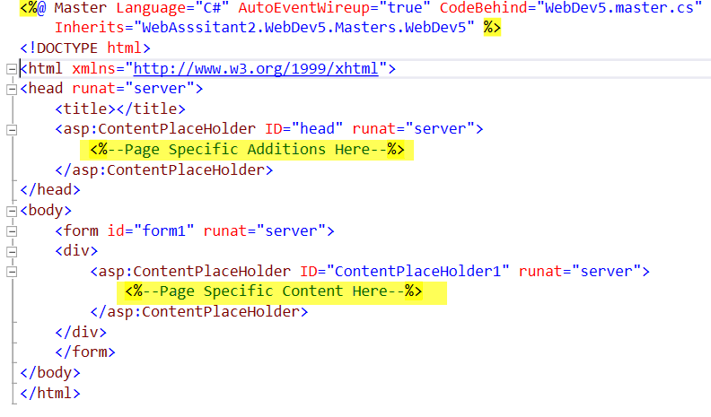
Master Pages
Notes:
Notice that the master page contains an HTML5 page with two placeholders. The placeholders are ASP controls that need to be submitted to a server before they are converted into appropriate HTML. Also the HTML page body contains a form. In Web Forms a web page can only contain a single form. There is also a comment at the top of the file which defines which language is being used in the code behind file. In this case there is a C# code behind file in which code can be placed to process user requests made when the web page is displayed.
In HTML it is possible to add code in a variety of languages, JavaScript being the most widely used. However it is much better to separate the pages functionality in separate code files than to mix it with HTML whose purpose is to contain the page content.

Slide 3
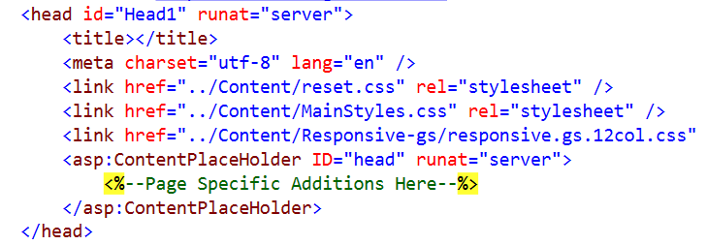
Master Page <head>
Store the master page in a folder
Notes:
The <head> of the master page contains all the links to the style sheets used to control the web sites overall look and feel. Master pages are usually stored inside a Masters folder thus all the links need to be updated!

Slide 4
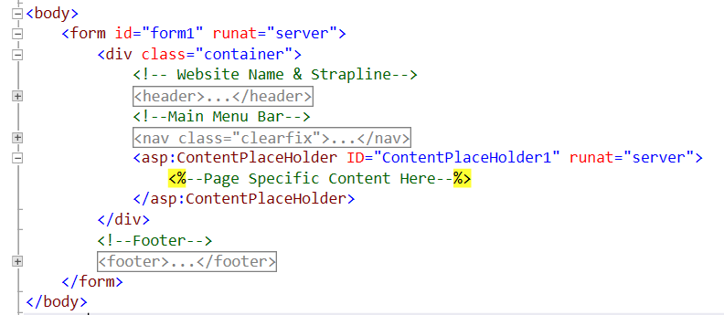
Master Page <body>
Notes:
The body of the master page contains the container <div>, the <header>, the <nav> and the <footer> with the placeholder.

Slide 5
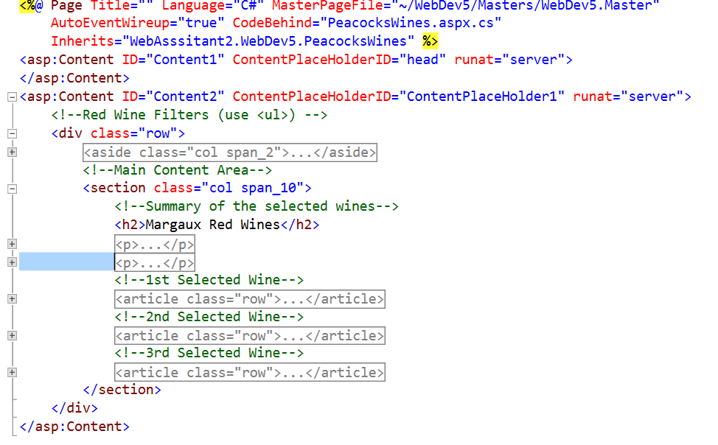
Using the Master Page
Notes:
Adding a new item Web Form Using Master Page provides a page with two content regions matching the two placeholders in the chosen master page. In this case one row <div> with an <aside> and one <section>. The <section> contains in this case three <articles>.

Slide 6
Browser View

Slide 7
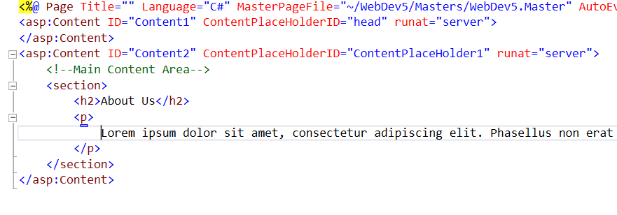
About Web Page

Slide 8
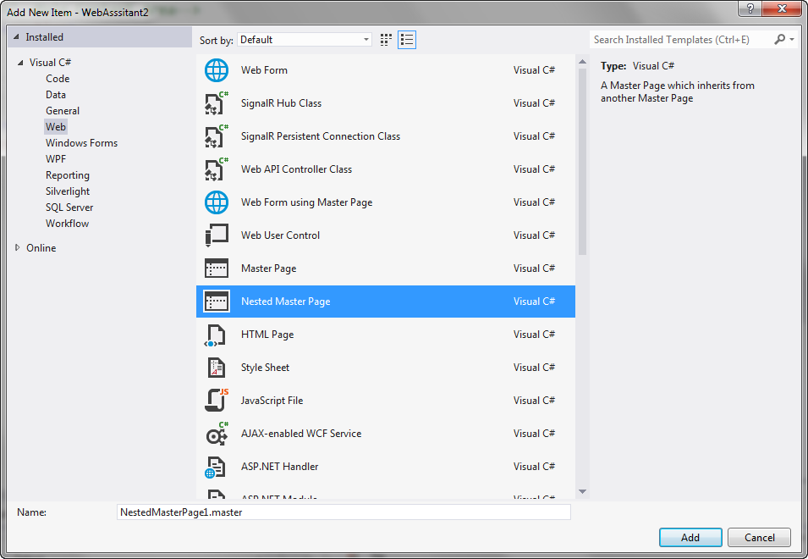
Unnecessary Duplication
Which pages will contain unnecessary duplication using this master page?
The only solution is to use nested master pages

Slide 9
Nested Masters
Top Level Master
Header
Main Menu Bar
Footer
Nested Master 1
Aside Navigation
ASP Form
Main Content
Notes:
If the side bar is used for secondary navigation and that navigation is the same for several pages, then Nested Masters is the only way in Web Forms to go in order to avoid unnecessary duplication. Several different Nested master can use the same top level master as their parent. In MVC a much better solution is available. Even Dreamweaver has a better solution using templates and library items to control the duplication.

