Slide 1
Using a Web Forms Application
By Derek Peacock
Notes:
This presentation contains notes on how to modify a standard ASP.NET Web Forms Application so that it uses previously designed Master Pages, Style Sheets and Web Page Design.

Slide 2
Add -> New Folders
Admin:
for staff database maintenance pages
Client:
for customers buying wines
Images\Wines:
Product image files
Masters:
Web Site master pages
Content\Responsive-gs:
Resonsive css framework
Notes:
As this is a full web site, it is important that the files are well organised into folders. Also as some pages can only be accessed by customers or staff security is added by using permissions set on the folders,

Slide 3
Transfer Existing Resources
Add -> Existing Item
CSS Style sheets
Product & Site Images
Add -> New Item & Copy/Paste
Master Page
Client Pages
Edit Image/Css links if necessary
Notes:
Some items can be transferred from previous projects to this new project by simply right clicking on the right folder and selecting Add -> Existing Item. However the web pages themselves have the names of previous folder and projects in their @Page settings, so it is usually quicker to create a new item, and then copy and paste the content from the previous pages. However in the new web site not all folder names are the same, so some links may need changing. Unfortunately Visual Studio has no Dreamweaver find broken links ability. You will have to find them manually.

Slide 4
Copy <Section id=“login”>
From Site.Master to MainSite.Master
Add New MS_Styles.css
Copy Login Styles to MS_Styles.css
Link in MS_Styles
Add float:right; to #login
Add float:left to header section{}
Adjust colours
Notes:
In the Microsoft Master page there are controls to provide registration and login facilities. These need copying and pasting into the new master page. There will not work well without their associated styles, so add a new MS_Styles.css style sheet and copy the login styles into it. Link it after the mainstyles style sheet in the master page head.
To get the login asp controls in the page add the login styles to MS_Styles, and float the login to the right and header hgroup to the left. I have removed the background and foreground colours for #login a

Slide 5
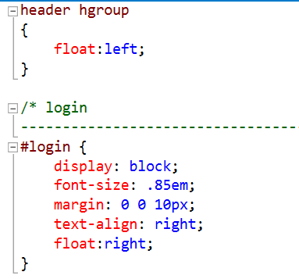
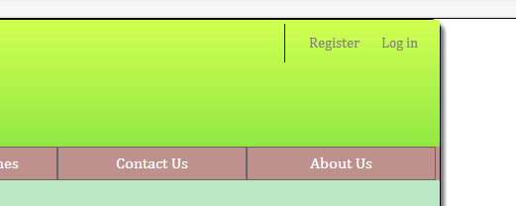
MS_Styles
Notes:
The register and login links should appear in the top right hand corner of the page header.

Slide 6
Modify Register Page
Change the name of the MasterPage content placeholder from ContentPlaceholder1 to MainContent in web page and register page.
Notes:
To change the register page so that it has the same styles as other pages just change the name of the master page in the page properties, and change the name of the content placeholder to MainContent in the master page and the client pages.

Slide 7
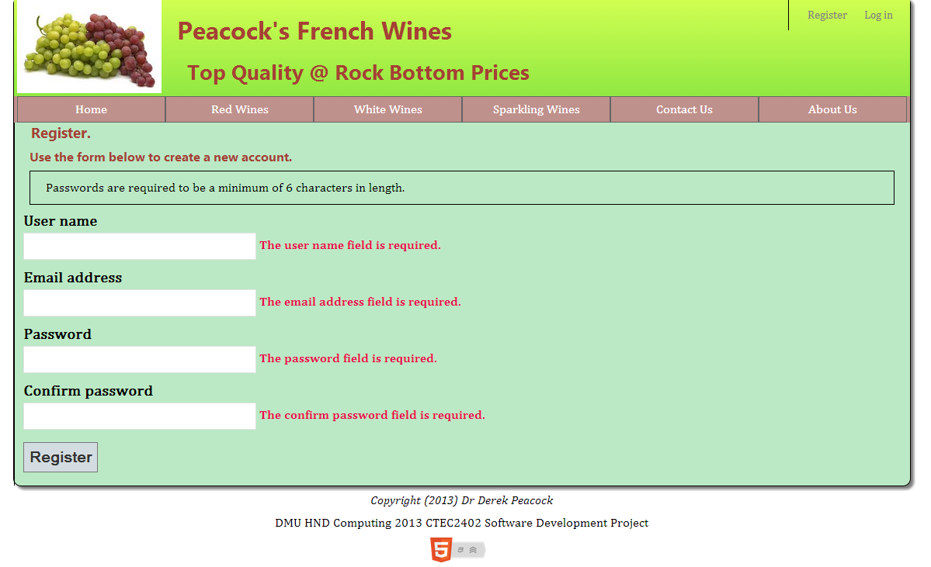
Style Register Page
Add a section outside register content
Copy Forms styles from Site.css into MS_Styles.css
Change h1=>h2, h2=>h3
Notes:
Using the Forms.css created earlier does not work as the <form> tag surrounds the whole page. So instead copy the Microsoft forms styles into the MS_Styles sheet. The headings need changing as in my view the page already has an h1. However you could alternatively define a new style for h1. To add padding into the page a section is added to surround the content,

Slide 8
Login Page
Notes:
The login page will simply need the master page changing.

