Slide 1
Three Layered Architecture
Analysis by Dr Derek Peacock

Slide 2
What makes for a “Good” class
Avoid
All-knowing, all powerful-classes
Classes with just data
Classes with just methods
Look for
Class has central purpose
Name that describes central purpose
Methods that are obvious to use
Contains no unrelated information

Slide 3
Good classes continued
Does not expose member data
Hides implementation details
Loosely coupled
Cannot be easily split

Slide 4
Good Methods & Properties
Good Methods
Does one action well
Name is of form Verb-Noun or description of return value
Loosely coupled to other methods
Few, obvious and well ordered parameters
Good Property
Accurately describes the data it represents
Real world name rather than programming artifact
Clear, unambiguous but short (no abreviations)

Slide 5
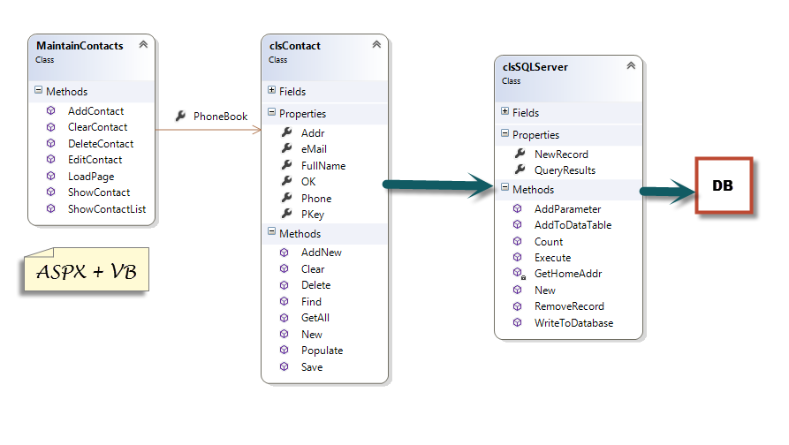
Advanced Programming

Slide 6
CTEC2902 Issues
User Interface contains expected methods, but not with the correct names
What is clsContact, is it one contact or is it a PhoneBook (list of contacts)
Contact contains the properties of a single contact
Contact contains the methods of a list of contacts
What is clsSqlServer?
What does SqlServer do?
What does SqlServer contain?

Slide 7
CTEC2902 Poor Names
Addr, OK, Pkey, AddNew versus New?
Populate what?
AddPrameter to what?
AddToDataTable, what data table?
Execute what?
GetHomeAddress what home address?

Slide 8
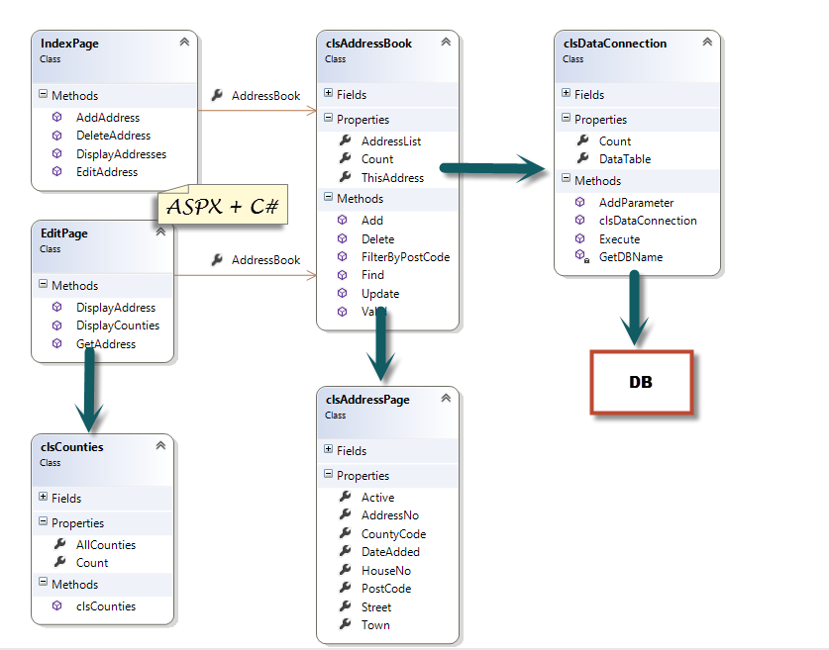
Visual Web Development

Slide 9
IMAT1604 Issues
Overly complicated for 1st year students
Not clear what DataConnection is executing
Not clear what the Parameters are?
Each web page contains an Address and an AddressBook sometimes with the same name.
Counties lookup list adds complication not present in Advanced Programming
Unnecessary duplication of code in Web Page
Why not pass an Address object
Data Validation not done in web page but in AddressBook (could fail??)

Slide 10
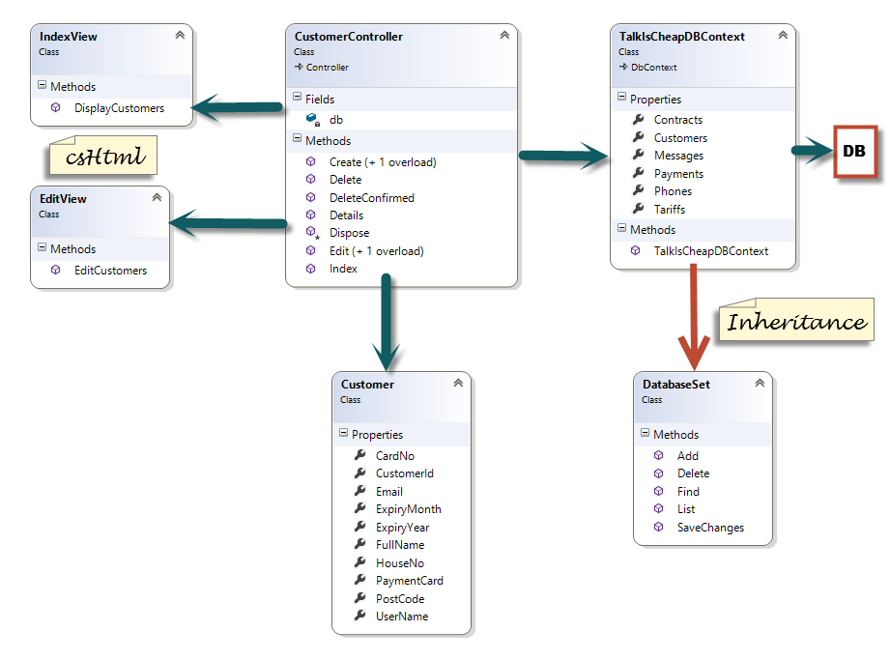
MVC

Slide 11
MVC Issues
No Design View
Built in naming convention, the Customer controller has to be called CustomerController
The Customer class must be called Customer and not Customers
The web page that edits a Customer must be in the Views/Customer folder and called Edit.cshtml

