Slide 1
Styling HTML5
By Derek Peacock
Notes:
A step by step guide to taking a standard HTML5 page and styling it to contain a header, a horizontal menu bar, a simple one column main content, and a footer.

Slide 2
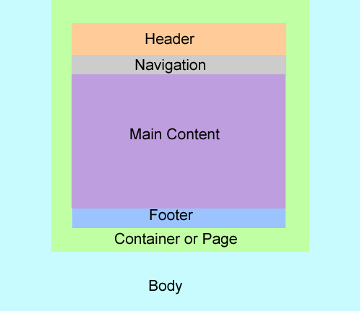
Basic HTML5 Page
<body>
<div id=“page">
<header>
<img src="http://placehold.it/120x90"> <h1>Web Site Title</h1>
</header>
<nav>
<ul>
<li><a href="#">Menu Item 1</a></li>
<li><a href="#">Menu Item 2</a></li>
<li><a href="#">Menu Item 3</a></li>
</ul>
</nav>
<section>
<p>This is the main content!</p>
</section>
<footer>
<p>Copyright Notice etc.</p>
</footer>
</div>
</body>
Notes:
The header, navigation, content and footer are all inside an enclosing <div> so that they can all share the same width and margins. The div is given an id name of page (or container)

Slide 3
Styling <body>
This is the area around the web page normally outside the left and right borders of the page.
Set suitable background colour and image
Select font family for paragraph text
Select default font size (100% = 16px)
body
{
background-color:#00CCFF;
font-family: Georgia, "Times New Roman", Times, serif;
font-size: 100%;
}
Notes:
The body is typically styled so that most textual content has the same font and font size. The body contains the entire page so that the background colour or background image will occupy the entire page background.

Slide 4
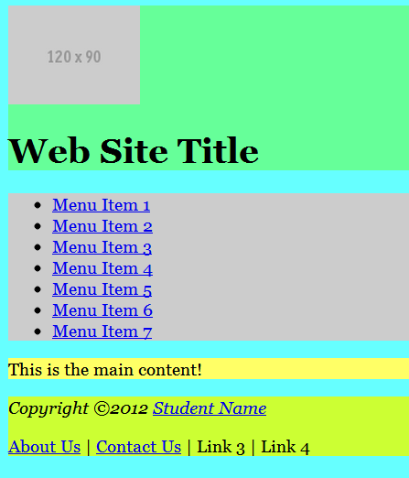
Adding Background Colours
header
{
background-color:#66FF99;
}
nav
{
background-color:#CCC;
}
section
{
background-color:#FF6;
}
footer
{
background-color:#CF3;
}
Notes:
In order to see where the different page areas are, each html5 tag is given a different background colour. These colours need to be all different, and will be changed later to match the chosen colour scheme.

Slide 5
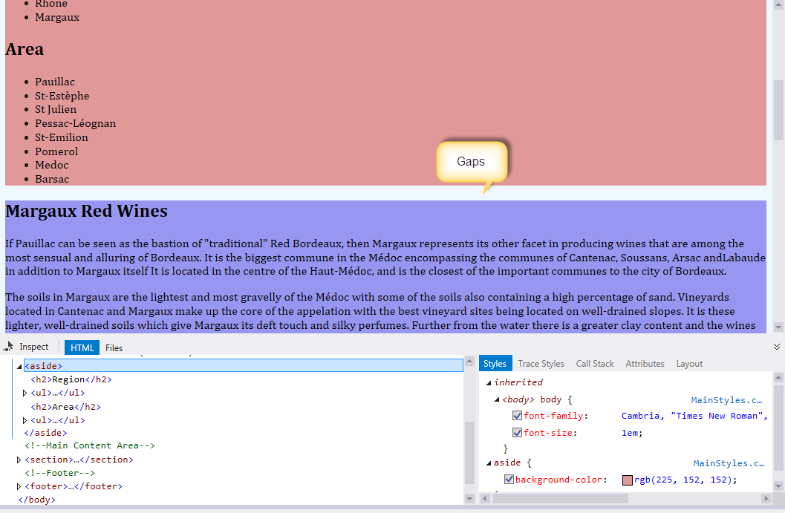
Design View & Page Inspector
Notes:
Unfortunately as soon as this is done, Dreamweaver’s design view shows it’s limitations. It does not display correctly. In order to see a more accurate view of the web page switch to Live View. The different areas should then be obvious, and the gaps between them apparent. Live view uses a webkit browser and is more accurate. However with HTML5 it is better to check in an up to date browser such as IE9, Firefox 10, or Chrome 15.

Slide 6
CSS Reset
*
{
padding: 0;
margin: 0;
border: 0;
}
Notes:
Different browsers apply different default style settings to a web page, also it is difficult to arrange areas of a page to fit together if there is an unknown amount of space (paddings and margins) between them. Most web developers use a style sheet to reset all style settings to none or zero, so that there are no unknown settings already in force.
Attach the HTML5Reset.css style sheet to your web page to achieve this affect. As an alternative normalize.css can be used, the HTML5reset has however been designed specifically with HTML5 in mind. Make sure that the reset style sheet is the first to be linked in the web page.

Slide 7
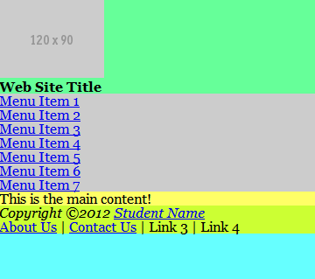
Using a CSS Reset
All space around elements removed
Will look the same in all browsers
Including Dreamweaver Live view (Opera/Web-kit)
Padding and margins re-added later
Notes:
With a reset style sheet in place there is no spacing between elements, even paragraphs have no extra spaces. This is not an attractive look, and space will have to be added back to the completed page. The page should however look identical in every modern browser (do not use IE8, IE7 or IE6).

Slide 8
<div id=“container”>
Needed to hold page parts together
Sets the overall width of the page
Positions the page on the screen
#container
{
background-color:#66cc66; /*green*/
max-width:1160px; /*responsive design*/
margin: 0 auto; /*Centre the page*/
}
Notes:
Most web sites display their pages in the centre of the screen as monitors today can vary between 1000 – 2000 pixels wide. It is however difficult to read text that is wider than 900 pixels, so 960 pixels is widely used for web page width as it leaves some room around the page for margins and drop shadows.
Create this rule in the attached style sheet.

Slide 9
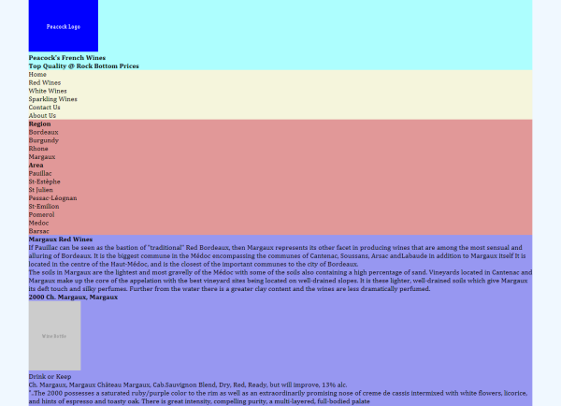
<div id=“container”>
Notes:
To apply a rule based upon an ID name, the name needs to be used in a single HTML tag such as <div>
When applied the web page should look something like as shown above. The page sits in the centre of the screen surrounded by the body colour.

Slide 10
<header>
Usually a fixed height with the name of the site, images. Logo and corporate colours.
header
{
background-color:#CCFF00;
padding: 4px;
height: 128px;
}
Notes:
Headers are usually of fixed height. The height should be just sufficient to enclose the image. To ensure that there is some space around the image, padding is added inside the header.
When this rule is applied there will be a problem in that there will not be enough room for the image and the heading below it. That will be fixed when the web page main heading is moved up to the right of the image.

Slide 11
Commenting css Sheets
Fonts
Body : Cambria, 'Times New Roman', serif;
Filename: MainStyles.css
Site: Peacock’s Wines
Author: Dr Derek Peacock
Version: 0.1
Changed: 1st September 2013
Description: A Basic HTML5 Style Sheet
TOC
* HTML Selectors
** Body
** Header
** Nav
** Footer
* Class Selectors
* ID Selectors
Notes:
Comments can be added to style sheets inside /* and */
The comments should include the name of the author, the filename, the web site name and a description of the sheet together with how the selectors are organised. One way of organising is to have html tags first, then classes and then ID names. Within the tags they should be kept in rough order of top to bottom of the page.
They can be most easily organised in design view by dragging and dropping selectors in the CSS Styles panel.

Slide 12
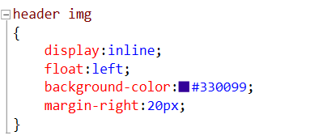
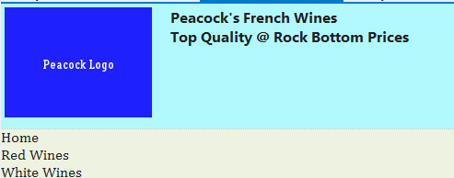
Floating Elements
Notes:
To get the headers heading to move up to the right of the headers image, create a style rule for the header’s image. In this case the display property is changed from block to inline. Block display mode displays the element and then moves to the next line. Thus block elements get arranged one under the other. To get elements to be on one “line”, change display to inline and then the element is floated to the left.

Slide 13
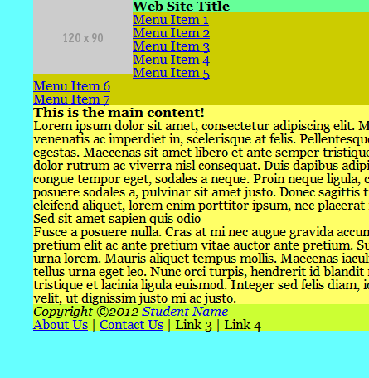
Browser View
Other items have floated
Floats need clearing
Clearing floats is not easy in different browsers
Notes:
The problem with floating is that once started it does not always stop. Typically other elements other that the target element get floated as well, as shown above. Here the menu entries have floated into the header region. Floats have to be cleared once they have floated the target element(s). However clearing floats so that it works in all browsers is very difficult.

Slide 14
clearfix
.clearfix:before,.clearfix:after
{
content: "\0020";
display: block;
height: 0;
overflow: hidden;
}
.clearfix:after { clear: both; }
.clearfix { zoom: 1; }
Notes:
Clearfix has been around for a while, and more modern versions are available (http://perishablepress.com/new-clearfix-hack/ ). Add this as a separate style sheet and attached it to the web page.

Slide 15
Applying class=“clearfix”
<header class=“clearfix">
<img src="http://placehold.it/160x120">
<h1>Web Site Title</h1>
</header>
Notes:
To apply group, add it as a class name to the enclosing html tag, e.g. the <header> in this case. This can be done in design mode if the element (header) is selected first in the bottom of the main window in Dreamweaver, and then the class name selected from the drop down list in the properties panel.

Slide 16
<header><h1>
header h1{
margin-top:15px;
font-size: 2.0em;
}
header h2{
font-size: 1.67em;
}
h1, h2, h3, h4{
font-family: Tahoma, Verdana, sans-serif
}
Notes:
The heading in the header will usually need to be styled differently than <h1> headings with a different size, color and font. Create a compound rule for a header h1.

Slide 17
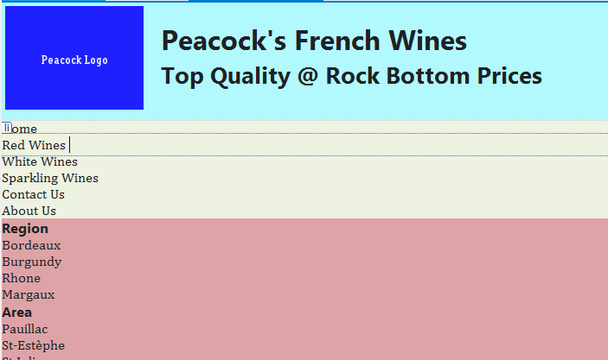
Design View
Notes:
To get the headers heading to have space between it and the image, you can create a rule for the header img (the headers image). You might also need to add top margin to the header h1 to move it down a bit.

Slide 18
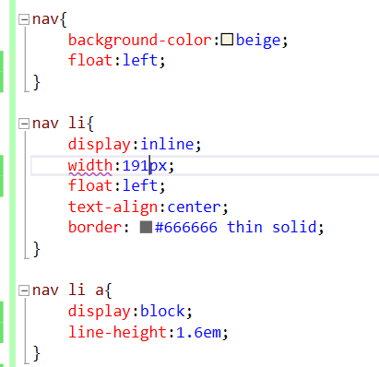
Nav Bar - More Floating
Notes:
The menu bar can be created in a similar way. Firstly float the nav. The nav li (navigation list items) are then displayed inline and floated left. They are given a suitable width so that in total they occupy the whole width of the page. This can be done in pixels so that they fold over if the screen width is reduced. Adding a thin solid border puts each menu entry in a box.
The menu entries hyperlink (nav li a) is then styled to display block. This is necessary to ensure that the hyperlink occupies the entire list item box with the text value centred, and no underline on the link.
A simpler approach would be to display the list items inline, but then they would all bunch to the left, and each menu entry would not be the same size.

Slide 19
Horizontal Navigation
Notes:
In the view above you can see that the menu entries are not yet wide enough to occupy the whole page with. Just change the width until they fit.
To stop the contents of the page moving up into the menu bar you may have to apply the clearfix class to the nav tag.

Slide 20
Hover and Focus
nav li a:hover,
nav li a:focus
{
background-color:#FF9966;
}
Notes:
To get the menu entries to show the correct appearance when the mouse hovers over the link or the user uses the keyboard to select the menu entry, the hyperlink’s hover and focus events have to be styled so that the background colour appears when the menu entry is about to be selected. In this case only the background colour changes, however other affects can be added if required.

Slide 21
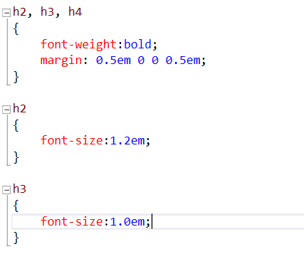
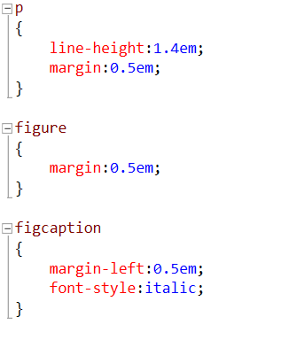
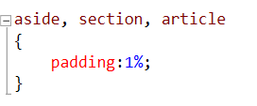
Adding Space back
Notes:
As all headings have been reset, appropriate style rules need to be defined to add the sizing and spacing back to the headings. Line-height and colour could also be added if desired

Slide 22
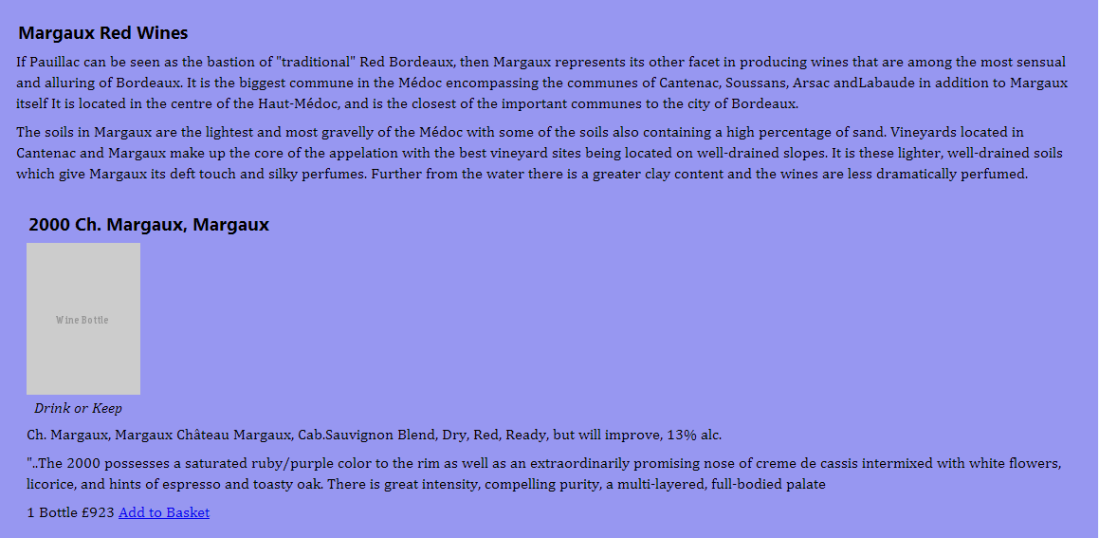
Browser View
Notes:
Space needs to be added back to paragraphs, line-height has been added to improve readability. Padding has been added inside the sections and articles, as well as margins around paragraphs and figures.

Slide 23
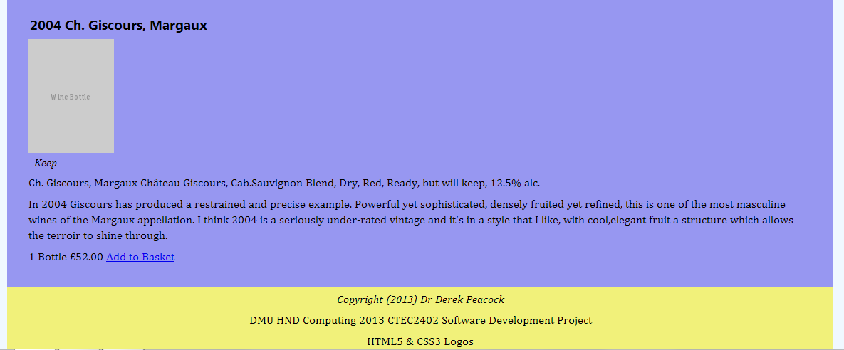
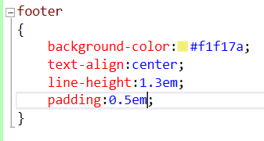
Styling <footer>
Notes:
The footer should be centred and given more space to complete the styling of this typical html5 page.

Slide 24
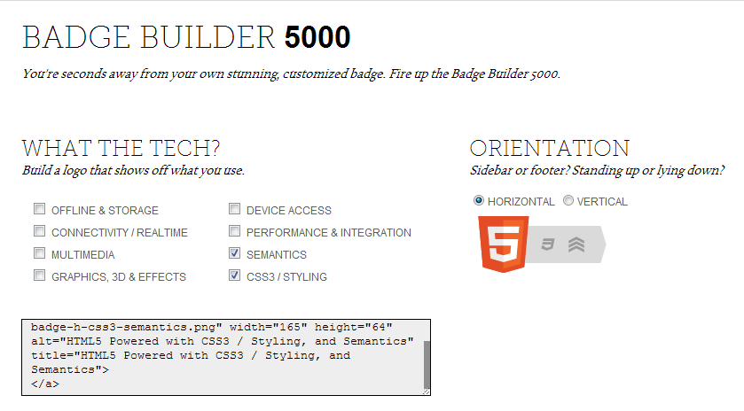
HTML5 & CSS3 Logos
http://www.w3.org/html/logo/
Notes:
W3.org provides a badge builder from which the appropriate code can be copied and pasted into the last paragraph of the footer. So far we have only used a small part of what HTML5 has to offer, the semantics and some styling.

Slide 25
Browser View
Notes:
Hover over the badge and the title will pop up explaining which aspects of HMTL5 have been used.

