Slide 1
Security - Forms Authentication
By Dr Derek Peacock
Notes:
Most web sites have to restrict access to certain pages to specified users or groups of users. Microsoft’s Membership Framework looks after such authentication.

Slide 2
Web.config
Alternative is Windows mode
SQL Server File Type
Project Name
DateTime
Notes:
By default security is built in to a ASP.NET Web Forms application or an ASP.NET MVC application, and the settings are already in the root level web.config file. Forms mode is best used with internet applications and Windows mode for intranet applications. In forms mode the use must enter a username and password to access the pages where access is limited to authorised users.
By default usernames and passwords will be stored in a local SQL Server LocalDb database file stored in the App_Data folder. This database is automatically created when the first user registers.
All these settings can be changed.

Slide 3
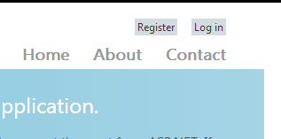
Initialise the Database
Notes:
To create the SQL Server database to store user names and passwords, run your application and select Register. By default passwords need to be 6 or more characters.

Slide 4
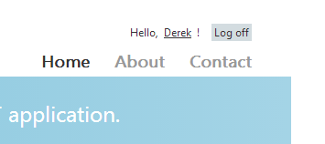
Login
Notes:
Once registered, the users name replaces the register link in the top right hand corner of the web page. To login again once log offed click on the Log In link.

Slide 5
Data Validation
Notes:
The register and login pages have built in data validation

Slide 6
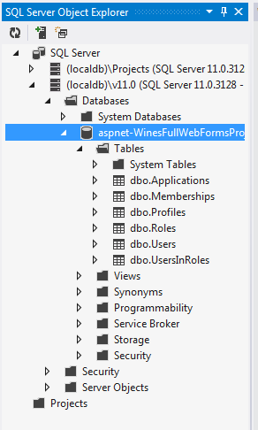
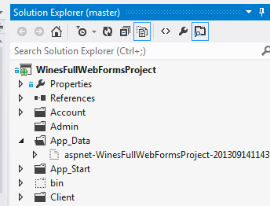
Accessing the Database File
Show all files
Notes:
For some reason the new database file is not automatically part of the project. This means the file is not displayed in the solution explorer, unless you display all files. You may need to refresh files first. To view the contents of the SQL Server database file, you need to view the SQL Object Inspector.

Slide 7
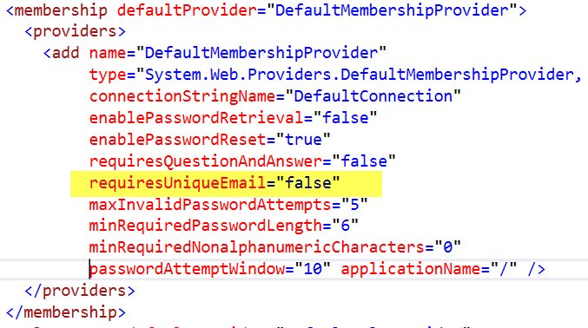
Membership Settings
Notes:
The membership security system can be configured in various ways. The standard settings are shown above. The only one I would be tempted to change for sure is that I believe each user should have a unique email address in order to avoid confusion.

Slide 8
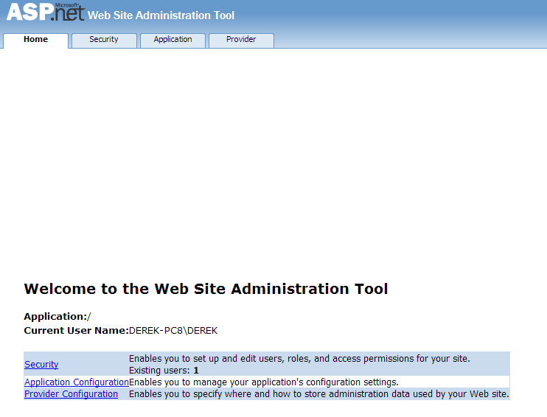
Setting Up Roles
Notes:
In order to assign different roles to different users, go to Project => ASP.NET Configuration, and then select security.

Slide 9
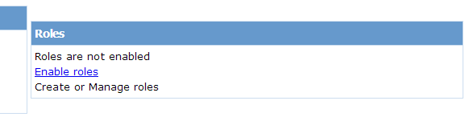
Enable Roles
Notes:
Before you can create roles, roles need to be enabled and then different roles such as admin and client can be created and added.

Slide 10
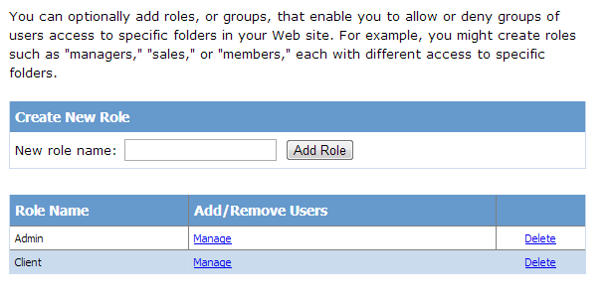
Roles Added
Notes:
Once roles have been added then you can click Manage to assign a role to a user.

Slide 11
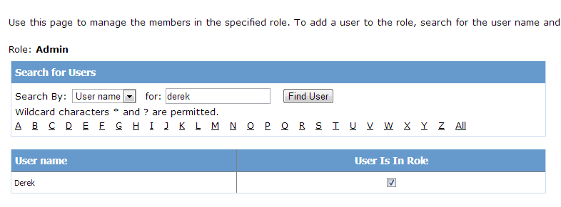
Roles Assigned
Notes:
Once roles have been created, they can be assigned to chosen users, or all users. Enabling roles is a setting written into the web.config file.

Slide 12
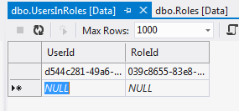
Database Content
Notes:
The membership database has been greatly simplified in Visual Studio 2012 compared to earlier versions. It is however easier to use the ASP.NET configuration pages, although descriptions for roles could be entered directly.

