Slide 1
HTML Forms
By Derek Peacock
Notes:
This is a short introduction into creating simple HTML forms. Most of the content is based on HTML, with a few HTML5 additions.

Slide 2
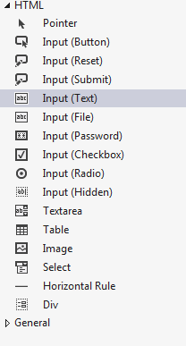
HTML5 Form
Notes:
Forms should be given a Name and an ID to make it easier to code their actions, however such coding will not be covered at this point. The usual method is to Post the forms results so that the data it contains can be stored in a database or acted on in some other way. The alternative is a Get method which is typically used for search forms where the page is updated when the search is submitted.
The action specifies which web page will be called after the Submit button is pressed.

Slide 3
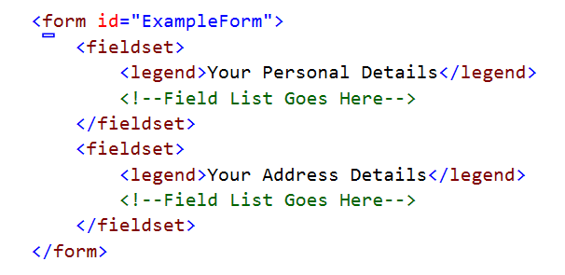
Fieldsets
Design View
Notes:
Forms contain fields, and fields can be sub-divided into fieldsets. Each fieldset is part of the form. So for example a simple form might contain two fieldsets, the first containing the person’s personal details, and the next the person’s address. In this form there will only be one fieldset. Each fieldset can have a legend which is shown to the user to help identify what the fields are about. In this form there will only be one fieldset.

Slide 4
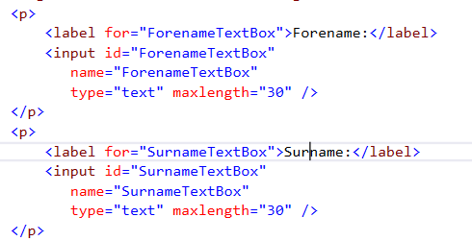
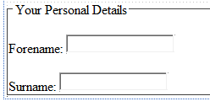
Inserting TextFields
Notes:
The most common field in a form is the TextField which can be used to take in single line text. Each TextField should be preceded by a Label, so the simplest way is to use design view. Press return or enter at the end of the legend to get an empty paragraph and then drag Input (Text) into the paragraph. The lable will have to be entered in code view. Inside the Label tag enter what the user will see (e.g. Surname).
The TextField can either be inserted immediately after the Label, or press return or enter to get another empty paragraph so that the TextField is on the next line. Having the label on one line and the TextField on the next line is much easier to style. Text boxes can also be separated by </br> or <div> tags.
Each TextField should be given a different name, and the size of the Textfield can be set by CSS. There is also a MaxLength attribute and if the Max Length is greater than the size (width) then the text will scroll horizontally to allow the editing of text that is bigger than the text box displayed.

Slide 5
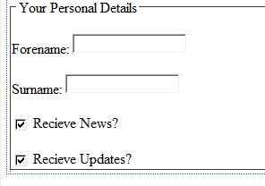
Input type=checkbox

Slide 6
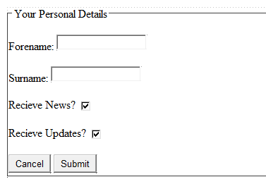
Form Buttons
Notes:
Buttons are usually added to forms without labels as the display the value attribute anyway. The value can be altered in design view (or code view), as can the action. There are only two actions, and the reset action is not that useful to users as they are unlikely to want to fill the form in twice with completely different entries.

Slide 7
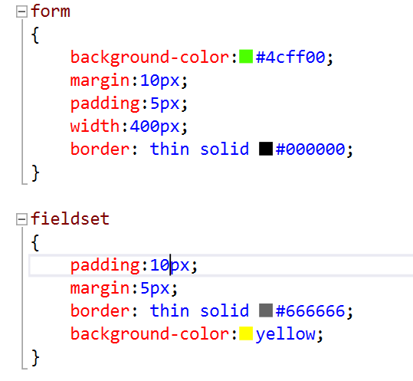
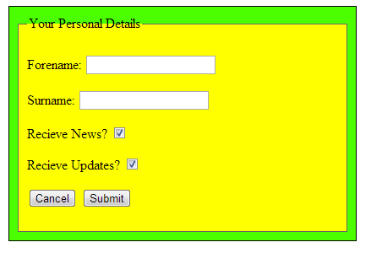
Styling Forms
Notes:
Styling a form is fairly straight forward with two exceptions. If you want labels to be the same length, and in the same line as the TextFields then they need to be made inline-block and given a width. Width on its own does not work as the “extra spaces” are stripped off if it is not made block-inline.
As both TextFields and buttons use the same <input> tag, in order to style just the buttons the type attribute has to be added to the input tag in square brackets.

Slide 8
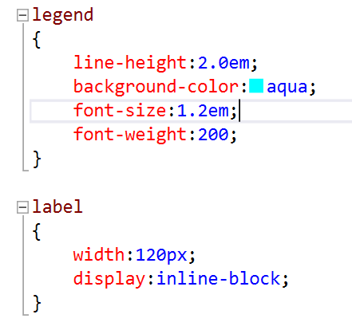
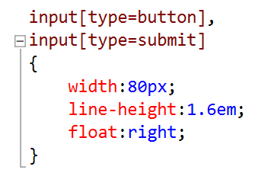
Styling Forms (2)

Slide 9
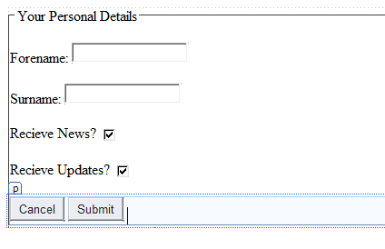
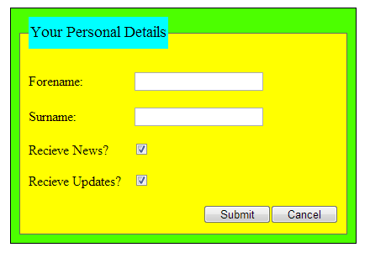
Design & Browser View
Notes:
Design view does not always work for some reason. However the Page Inspector view is ok.

Slide 10
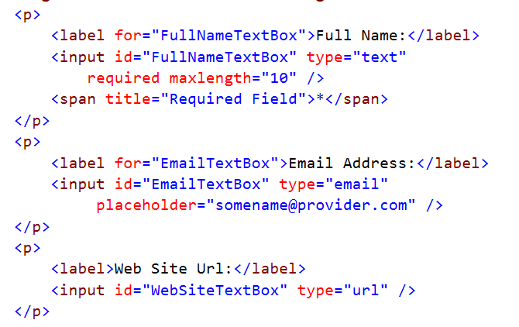
HTML5 Form Validation
Notes:
HTML5 has many additions that are very useful form forms. In particular there are more types, including email. Changing type=“text” to type=“email” will (in modern browsers) add client side (i.e. immediate feedback) that you have entered an invalid email address. This kind of data validation greatly simplifies the need for added data validation code.
You can also add Placeholders which appear in grey, and disappear as soon as the user enters the TextField. Placeholders can give the user a better idea of what entry is required for the field. These additions need to be done on code view at the moment. Dreamweaver has not yet included them in design view.

Slide 11
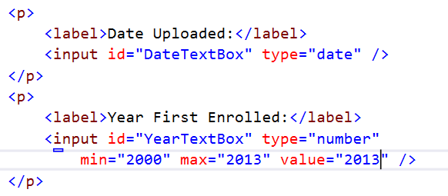
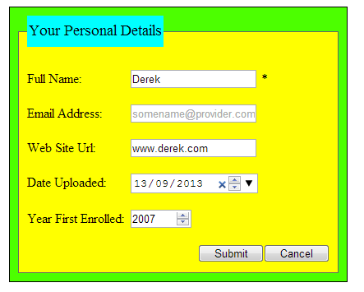
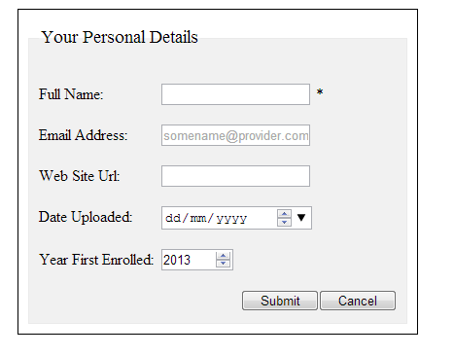
Dates & Numbers
Notes:
Required fields can simply add the required attribute to the <input> tag and the form will check that the user has entered an entry in the field before it is submitted for processing. However to provide the user with some indication that the field is required needs an * symbol added to the label inside a <span> tag so that it can be formatted in red whilst the label itself is in a more normal colour.

Slide 12
Other Validation
Date, DateTime and Time
Month and Week
Tel
Search, password, hidden
DataList
color, image
Autofocus, Autocomplete
File and multiple files
Range, Patterns, Steps

