Slide 1
HTML5 Semantic Tags
By Dr Derek Peacock
Notes:
This presentation introduces the new HTML5 structural tags that can be used to divide a web page into typical areas such as header and footer.

Slide 2
What is new?
New Tags and attributes
Native Video & Audio
2D/3D Canvas with hardware support
SVG
Local storage and local SQL Databases
Web workers and messaging
Drag and Drop
Geolocation
New input types, and data validation

Slide 3
Basic Block and Inline Tags
<div> Division
<h1> Headings
<p> paragraphs
<ul><ol> Lists
<table>
<a> hyperlinks
<img> images

Slide 4
Dividing a Page into Blocks/Parts
<div>
<div>
<div>
<div>
HTML
<main>
<section>
<article>
<header>
HTML 5

Slide 5
HTML5: <header>
The <header> tag is used to specify a header to the page or a part of the page.
<header>
<img src=“logo” alt=“logo”>
<h1>Website Name</h1>
</header>
Notes:
The header tag can be used to define an area typically at the top of a web page where the title of the website and identifying logos or images can be found. Headers can also occur elsewhere in the page. An article for example could also have a header and footer. The page header should have a level one heading which contains the identity or name of the web site.
There might be other elements inside the header such as links, a search facility or a login area.

Slide 6
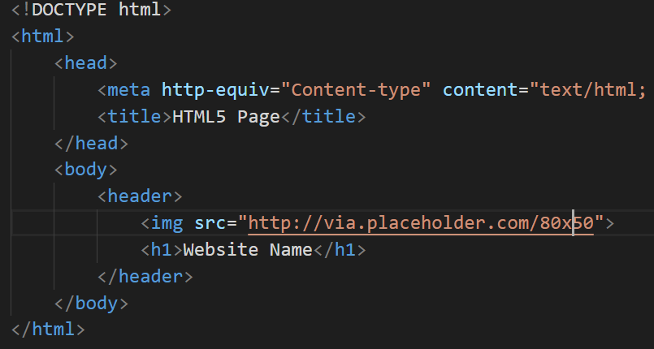
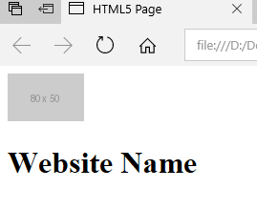
Header Code (repeated)

Slide 7
Page Structure
<html>
<head>
<body>
<header>
……
<footer>

Slide 8
HTML5: <nav>
The <nav> tag defines a main section of navigation links or a menu bar.
Not all links of a document should be in a <nav> element.
The <nav> element is intended only for major block of navigation links.
Notes:
Typically the <nav> element will contain the main menu entries for the page.
Browsers, such as screen readers for disabled users, can use this element to determine whether to omit the initial rendering of this content.

Slide 9
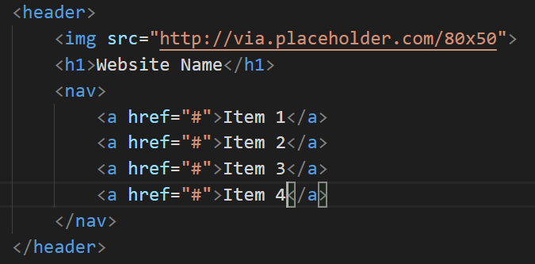
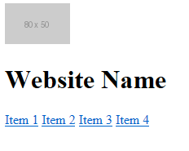
Website Menu (repeated)

Slide 10
HTML5: <main>
This should enclose the main content of a web page.
There should be only one main part of a web page.
Should contain unique content only
Cannot be part of section, article, header or footer

Slide 11
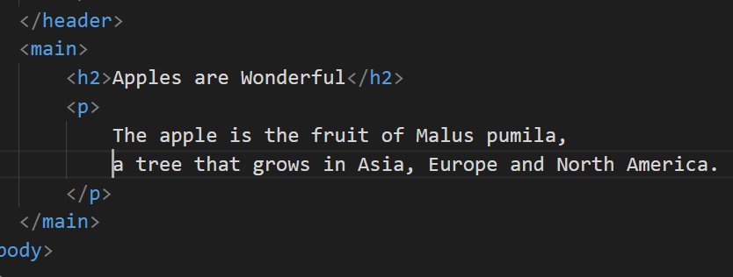
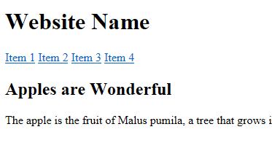
Main Content (unique)

Slide 12
HTML5: <footer>
The <footer> tag defines a footer for a document or section.
A footer typically contains the author of the document, copyright information, links to terms of use, contact information, etc.
Footers are typically placed at the bottom of a document. However, this is not required.
A document/section can also have more than one footer
Notes:
Footers are usually found at the foot of the page where they contain copyright and authorship information as well as less used links to pages in the web site such as About Us, or Terms & Conditions. Again section of the page or articles in the page might also have footers.

Slide 13
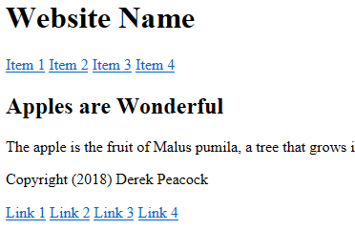
<footer> (repeated)
<footer>
<p>Copyright &copy; Derek Peacock 2018</p>
<p>
<a href=“link1”>Link 1</a>
<a href=“link2”>Link 2</a>
<a href=“link3”>Link 3</a>
<a href=“link4”>Link 4</a>
<p>
</footer>
Notes:
The copyright symbol has to be entered in code view as a special symbol preceded by the & character and ending in a semi-colon.

Slide 14
HTML5: <section>
The section element represents a generic section of a document or application.
A section, in this context, is a thematic grouping of content, typically with a heading.
Notes:
Examples of sections would be chapters, the various tabbed pages in a tabbed dialog box, or the numbered sections of a thesis. A Web site's home page could be split into sections for an introduction, news items, and contact information.

Slide 15
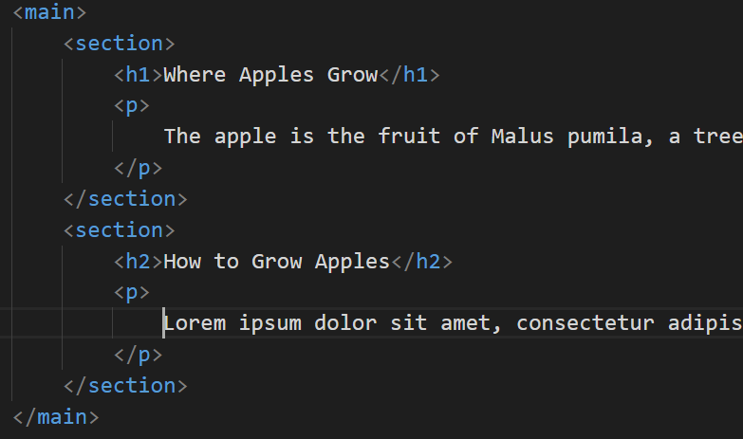
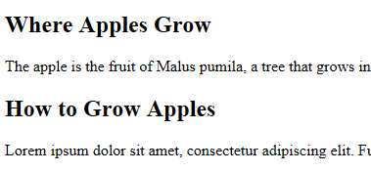
<section> example
Spot the mistake?
Notes:
A section is used to divide content up into equal parts, where all parts are required to complete the content. Typically the main content of a page will have a topic, and that topic will be divided into an introduction, a main section and a conclusion.

Slide 16
HTML5: <article>
The <article> tag specifies independent, self-contained content.
An article should make sense on its own and it should be possible to distribute it independently from the rest of the page/site.
Articles can contain sections, and sections cam contain articles
Notes:
Examples of possible articles:
forum post
newspaper article
blog entry
user comment

Slide 17
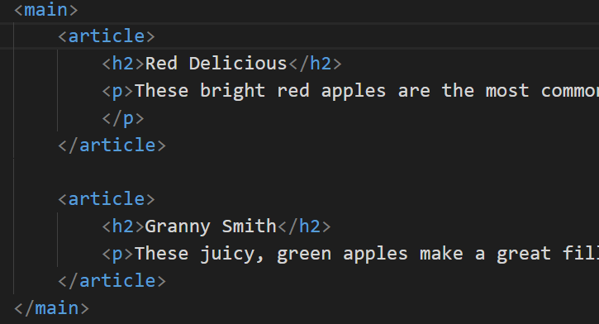
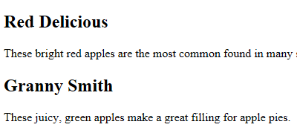
<article> example
Notes:
In this example the article is about apples. As the heading of the article has a sub-heading, it is best practice to group these to assist screen readers make sense of the heading levels. In this article there are two sections, one on Red Delicious and one on Granny Smith apples.
Thus an article can contain sections, and a section can contain articles.

Slide 18
<hgroup>
The <hgroup> element is used to group a set of <h1> to <h6> elements, when a heading has multiple levels (sub headings).
Notes:
Used to group two or more headings together.

Slide 19
<aside>
The <aside> tag defines some content aside from the content it is placed in.
The aside content should be related to the main content, but not essential.
<p>
My family and I visited The Epcot
centre this summer.
</p> <aside> <h4>Epcot Centre</h4> <p>The Epcot Centre is a theme park
in Disney World, Florida.
</p> </aside>
Notes:
An aside is typically referred to as a sidebar where supplementary or explanatory notes are show. These should aid the understanding of the main content, or contain supplementary images or useful links and notes.

Slide 20
<address>
The <address> tag defines the contact information for the author/owner of a document or an article.
If the <address> element is inside the <body> element, it represents contact information for the document.
If the <address> element is inside an <article> element, it represents contact information for that article.
The text in the <address> element usually renders in italic. Most browsers will add a line break before and after the address element.

Slide 21
<address> example
<footer>
<address> For more details, contact
<a href="mailto:js@example.com">John Smith</a>
</address>
<p>
<small>&copy; copyright 2038 Example</small>
</p>
</footer>
Notes:
In this case the address is an email address, it will appear as a hyperlink which when clicked on loads up the user’s email application such as Outlook.

Slide 22
HTML5: <figure>
The figure element can be used to annotate illustrations, diagrams, photos, code listings,.
<figure>
<img src="http://placehold.it/120x160”>
<figcaption>Some Image Caption</figcaption>
</figure>

Slide 23
Ed Sheeran
Create a suitable HTML structure for the example music page
http://www.edsheeran.com/music
using:-
<header><footer><nav><main><section>
<article> and
<video><button><a><p><img>
DO NOT USE ANY <div>
For help use W3Schools

