Slide 1
HTML5 Audio & Video
By Derek Peacock

Slide 2
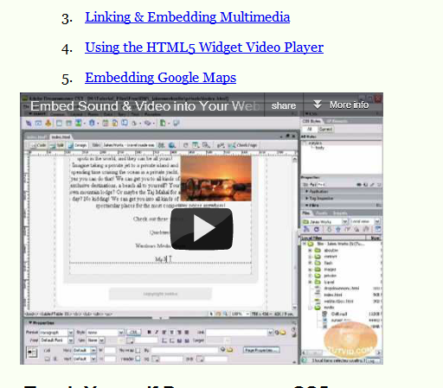
Linking & Embedding
<iframe
width="420"
height="315“
src=“http://www.youtube.com/...”
frameborder="0"
allowfullscreen>
</iframe>
Notes:
Linking simply provides hyperlinks to an external web page on another web server such as YouTube. Embedding provides a similar link to the external web server, but the video is embedded in the local web page and can be played without switching pages. In the above example <iframe> is used to provide a frame inside of which the video is enclosed. The video itself is part of another web site (YouTube in this case).
Iframes were an earlier technology used to break a web page up into separate frames (each frame was normally a separate file).

Slide 3
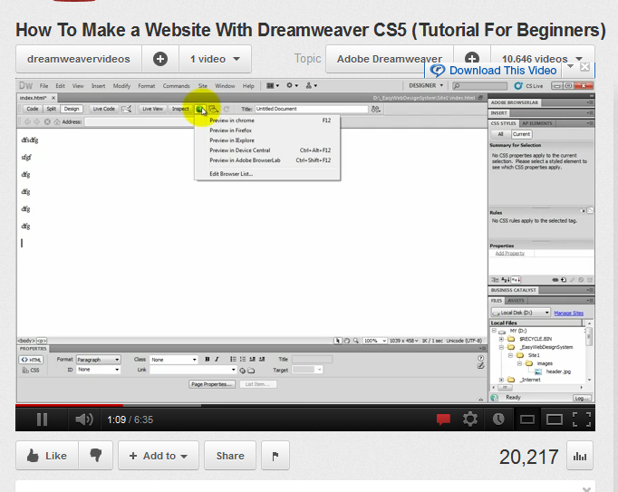
Embedding YouTube
Notes:
To get the code to embed a YouTube video click on Share, and then click on Embed

Slide 4
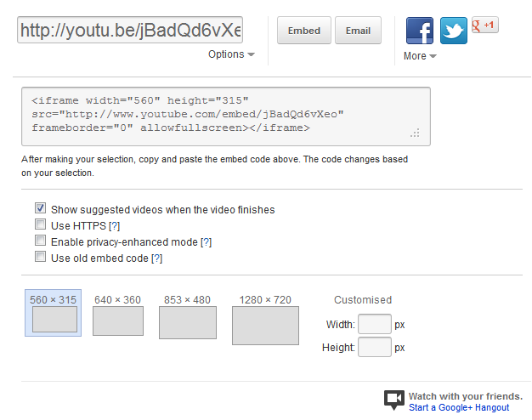
Embed Code
Notes:
YouTube provides code suitable for embedding, the code needs to be copied and pasted (in code view) into the right position in a web page. The window size for the displayed video can be selected before copying the code. Adobe and other web sites provide similar facilities.

Slide 5
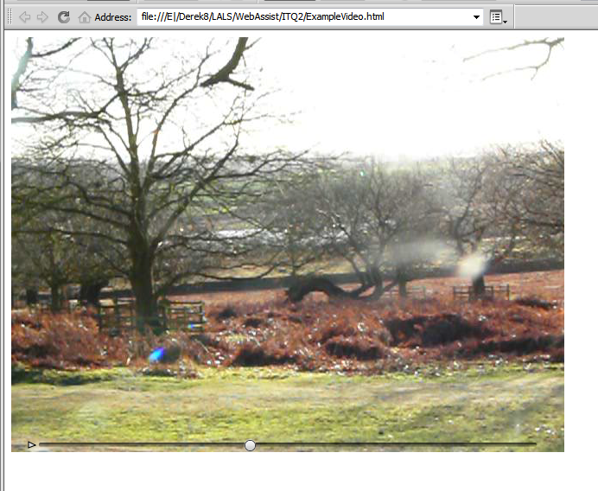
HTML5 Native Video
<video src="HTML5Sample.mov“
controls>
</video>
Notes:
To use a video in html5 the basics are very simple, a <video> tag with the source indicated by the src attribute, and a play and pause control added by the controls attribute. The size of the window is automatically adjusted to suite the native size of the video being played.

Slide 6
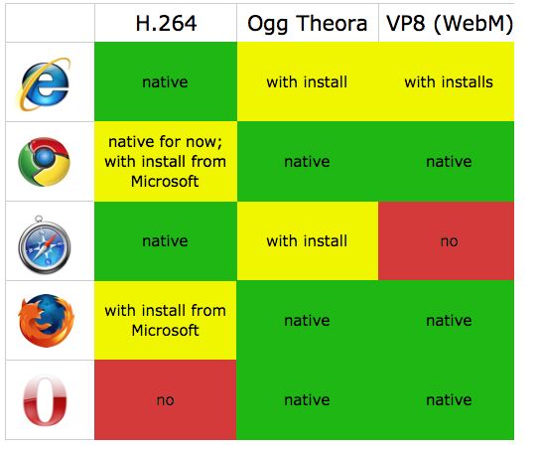
Browser Support
Notes:
There are three native formats to choose from, but there are not universally supported. To provide support for all browsers you need to provide the video in at least two formats, MP4 (H.264) and Ogg Theora. Alternatively Google have devised a new WebM format which could be used instead of Ogg.

Slide 7
Video Converters
Miro Video Converter: http://www.mirovideoconverter.com/
Handbrake: http://handbrake.fr/
Mpeg Streamclip: http://www.squared5.com/
Notes:
There are several free video converters available that will convert from a variety of formats into a choice of destination formats. Miro Video Converter supports all the new formats, unfortunately it failed to convert my mov file to MP4 or WebM. Mpeg Streamclip managed to convert it to MP4, but not WebM

Slide 8
Typical Code
<video controls width="640" height="480">
<source src="../Media/BradgatePark2.mp4">
<source src="../Media/BradgatePark2.theora.ogv">
<p>Browser does not support MP4 or Ogg Video</p>
</video>
Notes:
To provide support for multiple browsers, you can list alternative <source> and in this case if ogg and MP4 are not supported then there will be a message on the screen saying so. A link to download the video might however be more useful.

Slide 9
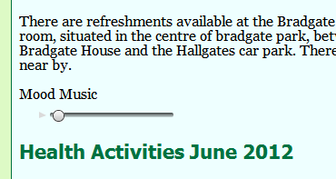
HTML5 Audio
<audio controls>
<source src="Audio/MinuteWaltz.mp3“
type="audio/mp3">
<source src="Audio/MinuteWaltz.ogg“
type="audio/ogg">
<p>No Support for mp3 or ogg!</p>
</audio>
Notes:
In a similar way HTML5 supports native audio, and again for multiple browser support you need to provide at least two formats. Most browsers support MP3 and Ogg. The Controls attribute provides a play and pause button. There are other attributes that can be added such as autoplay and loop.

