Slide 1
Using Tables
By Derek Peacock

Slide 2
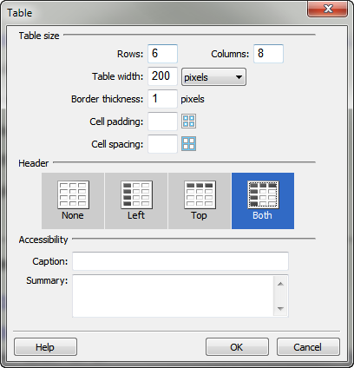
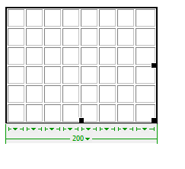
Creating New Tables
Notes:
Tables can be most easily created and edited in design view. Insert -> Table brings up a Create Table wizard in which the number of columns and rows can be specified, and certain rows and columns can be defined as row or column headers.
It is probably best to adjust the overall width of the table before typing in the table contents. The cells will adjust in width as content is added. Also column widths can be further adjusted by dragging column borders to the desired width.

Slide 3
Copy Data Tables
Copy & Paste data from spread sheet, or drag and drop sheet.
In design view select a column and change horz or vert alignment
In design view change column widths as required.
In design view select title row and make header
Notes:
If a table already exists in Word or Excel for example, then copy and paste the table in design view is the quickest way to create a web based table. Alternatively drag the excel file into design view from the files panel.
If you want to change the alignment of text within a column, then select the column and in the properties panel select Horz (short for horizontal alignment) and select Center to centre the text.
To make the first row of a table into table headers, select the row and click Header in the properties panel

Slide 4
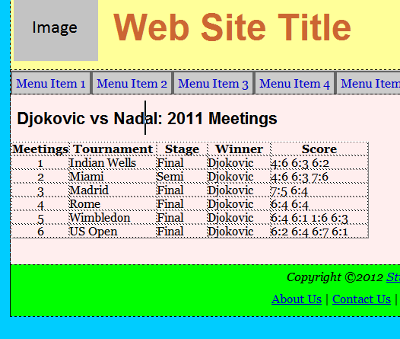
Data Tables
Notes:
The table will look similar to the one shown above where the first row are column headings.

Slide 5
<table><th><td>
<table cellspacing="0" cellpadding="0">
<tr>
<th width="76" align="center">Meetings</th>
<th width="115">Tournament</th>
<th width="67">Stage</th>
<th width="83">Winner</th>
<th width="128">Score</th>
</tr>
<tr>
<td align="center">1</td>
<td>Indian Wells</td>
<td>Final</td>
<td>Djokovic</td>
<td>4:6 6:3 6:2</td>
</tr>
</table>
Notes:
There is quite of lot of code needed to create an HTML table. The table is enclosed in <table> tags, and each row in the table is enclosed in <tr> tags.
Each cell in the table is either a <td> for a normal cell, or <th> for a row or column heading cell. As each table tends to have different column widths this is a case where some styling can be included in the html.

Slide 6
More Structure
<thead>
<tbody>
<tfoot>
<figure> <figcaption> <table> </table> </figure>
Notes:
Tables can be given more structured if needed for styling purposes. Tables can be subdivided into <thead>, <tbody> and <tfoot>. It you need to add a caption to the table then the table can be enclosed inside a <figure> and the caption added with a <figcaption>

Slide 7
Apply CSS Styles
table
{
margin-left:50px;
border: solid thin #000;
}
td, th
{
padding:8px;
border: thin solid #666
}
th
{
background-color:#0FC;
}
Notes:
Simple styling can be added so that the table has space around it (margin) and a border. All cells can also be given a border and some space inside the cells using padding. Finally yhr column headings can be made to stand out by selecting a background colour.

Slide 8
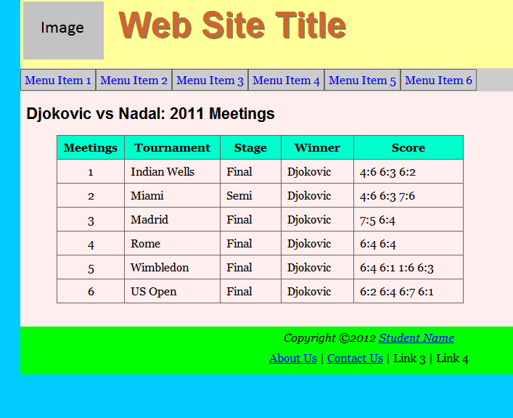
Table Appearance
Notes:
The screen shot above shows the effect of that simple styling on the example table.

Slide 9
CSS3 Tables
Notes:
Using CSS3 to style tables can result in tables that have very distinctive styles.

