Slide 1
Database Design Using Access
By Derek Peacock
Notes:
I believe that there are a number of advantages using Access as a Database Design tool rather than an ERD Tool. It can print data dictionaries, it can document data validation and it can test out the design by entering sample data

Slide 2
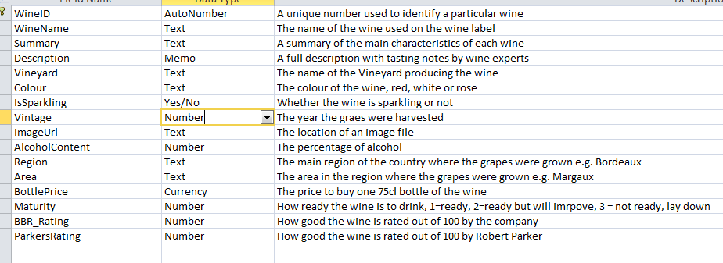
Table Design
Notes:
Basic Table design can be documented by adding a comment to each field. Each field can also be documented with data validation

Slide 3
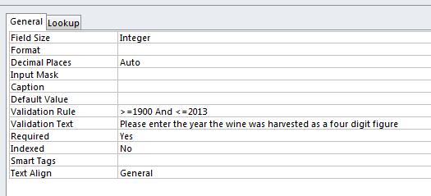
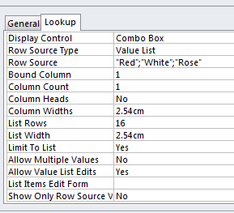
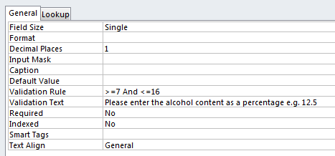
Data Validation
Vintage
Colour (Lookup Wizard..)
Alcohol Content
Notes:
Data validation is vital in order to ensure that mistakes are minimized, and customers provide all the correct information needed to complete the sale. However overuse of the required attribute can be irritating for staff maintaining the database. There are cases when not all the information for a new record is available initially. So some fields should be able to be left blank (or null) and filled in later when the information is available. Fields such as email and url can be validated by complex input masks or patterns more easily in ASP.NET than in Access.

Slide 4
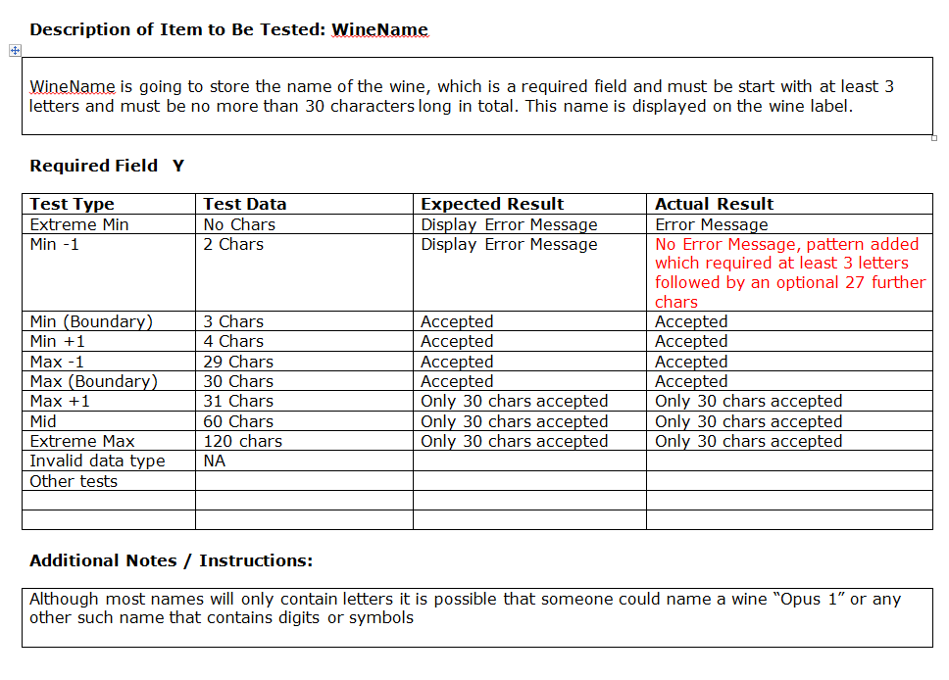
Test Data Plan
Notes:
While designing the tables and their field validation, that should be closely followed by creating the test data plan. Students have already used the above Test Data Log in the Visual Web Development module, so it is one possibility. Test Driven Development is possible using MVC, and in my view that is a better and more interesting way of automating test planning and testing.
This data log is very detailed and with 60 fields to validate it gets very boring and repetitive. Using MVC this would be wasted testing as data validation can be built into class annotations.

Slide 5
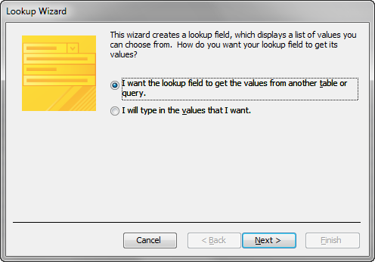
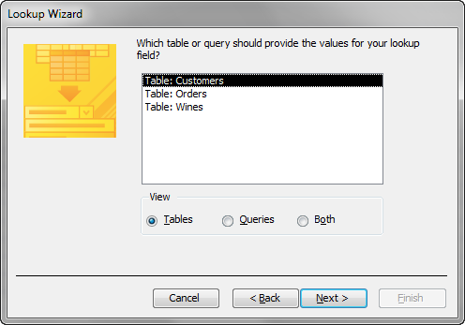
Relationships
Notes:
In the Orders table there is a relationship between Orders and Customes, a Customer may place one or more orders. Use the lookup wizard when entering the Foreign key CustomerID in the Orders Table.

Slide 6
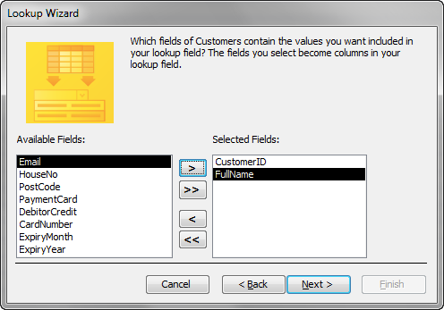
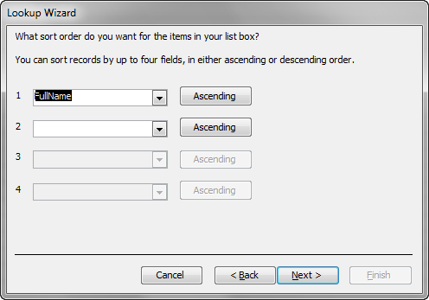
Include Other Fields
Notes:
One advantage of using a Full Name rather than forename and surname is that it can be used to identify which customer is which, (although it is not necessarily unique). The disadvantage is that customers cannot easily be listed in surname order. The optimal solution is two sepsrate fields, with a query field which links them together as FullName,

Slide 7
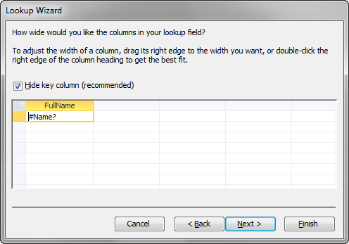
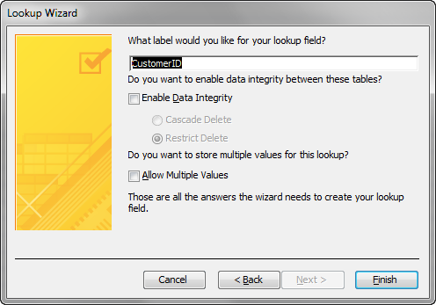
Hide the ID Field
Notes:
Users should never see ID fields as they have no meaning for them. However when testing developers need to see ID fields t check that the links are being correctly made.

Slide 8
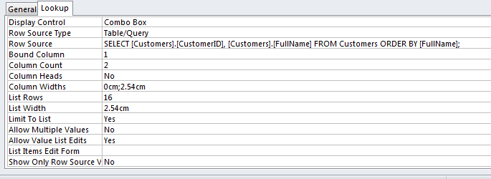
Internal Queries
Notes:
In practice Access creates an SQL query stored internally in the table object. The ID field has a column width of zero cm in order to hide it.

Slide 9
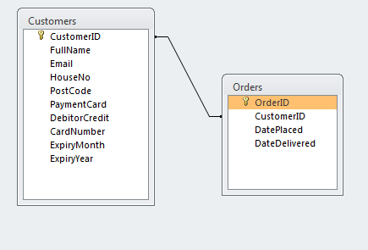
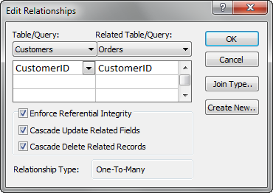
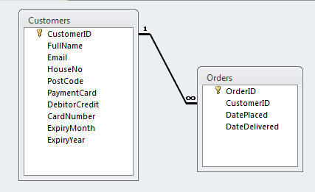
Referential Integrity

Slide 10
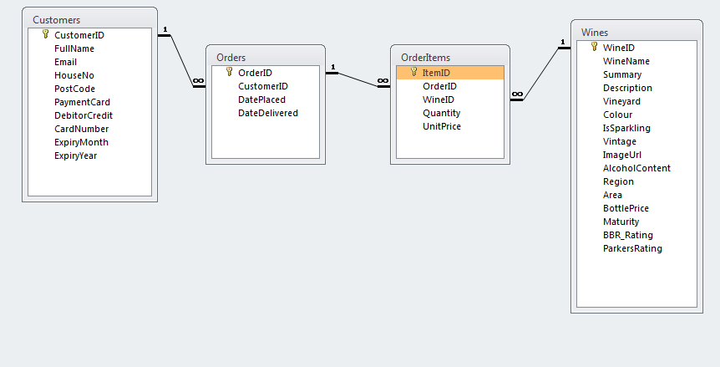
Order Items
Notes:
The actual content of the order are bottles of wine, but an order can be form many bottles, and each wine can be ordered many times. Although the purchase price at the time of order is the same as that in the wines table, the sale price is variable and may be subsequently changed, thus each order item has a unit price copied into it.

Slide 11
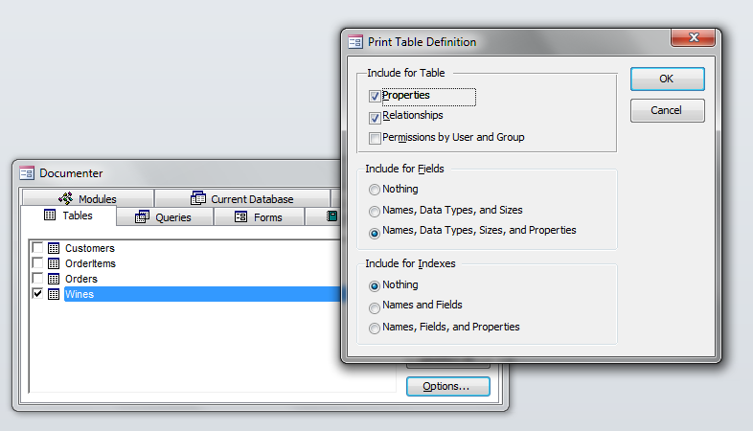
Database Documentation

Slide 12
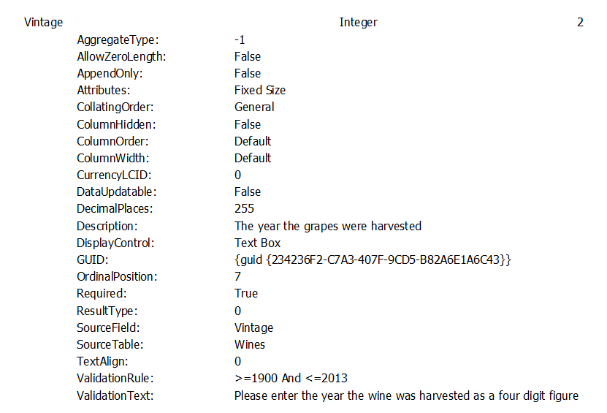
Field Documentation

Slide 13
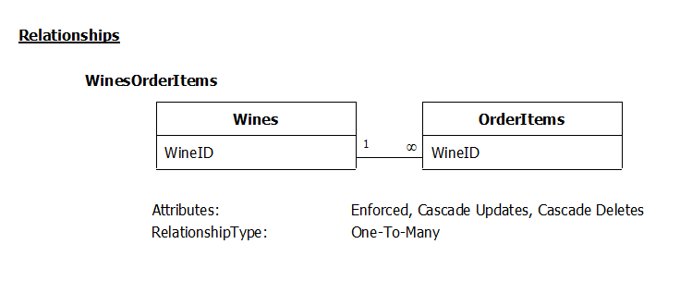
Relationship Documentation

Slide 14
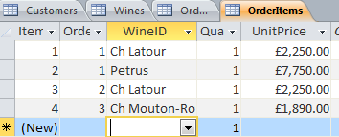
Minimal Test Data
Notes:
To test the design out, data needs to be added that is sufficient to show that the one to many, and the many to many relationships work. Usually three records is sufficient. However in this case the data must be incomplete as how can Gita be a customer without having placed an order? It is however possible to have some wines that no one has bought. Orders must have at least one order item.

Slide 15
Notes => Reflections
Anything essential missing?
Why limited to French wines?
Is Region unnecessary duplication?
Should Customer have more than one address/email/phone no/credit card?
Therefore should customer be split?
Should Wines be split into wine and vintage?

Slide 16
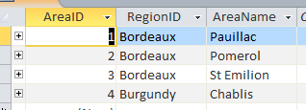
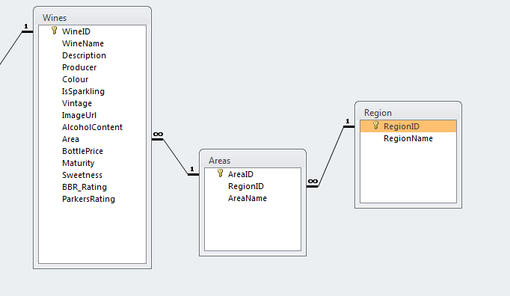
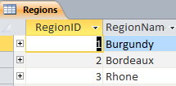
Regions & Areas
Notes:
By using lookup tables the duplication of the region names can be avoided.

Slide 17
Further Normalisation
Wines
Producer
WineName
Colour
Sweetness
IsSparkling
Area
Vintage
WineID
VintageYear
Alcohol
Description
Maturity
Rating
Price
1:Many
Notes:
The suggested Wines table is not normalised as the same wine is produced each year, and some attributes are the same for all years, and some are different each year. However in due of the shortage of time the single de-normalised table will be used.

Slide 18
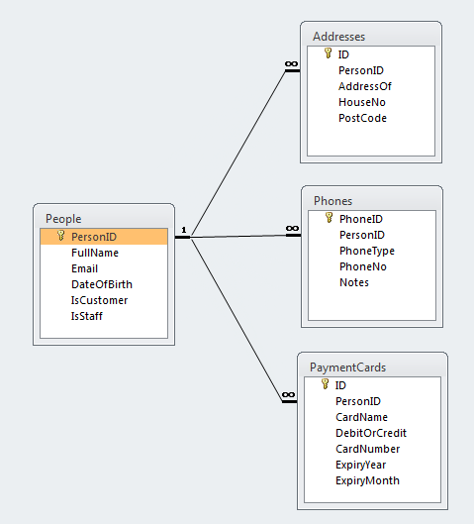
More on Normalisation
Notes:
In some web sites customer details can be more extensive as in the real world a customer may order wine for someone else, so the Billing Address will be different from the delivery address. To make matters worse two people living at the same address could order wine. In this case there will be unnecessary duplication of data. The duplication in this case is minor. You also may want more than one phone number for your customer in case of a query on the order

Slide 19
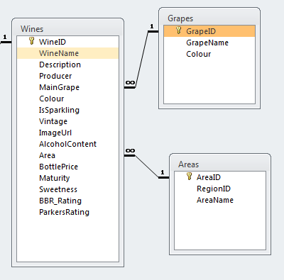
What About the Grape?
Notes:
I was aware initially that which grape the wine is made from is an important attribute of the wine. The problem is that some wines are made from a mixture of grapes. So I hesitated between recording all the grapes used in each wine (overkill perhaps?) and just recording the main grape. Or even having a single text field and just typing in all the grapes used, The problem with the last suggestion is that lookup tables cannot be used. In the end I put off the decision and then forgot to put any fields in!!!

Slide 20
Alternative Grapes
Notes:
You can of course have both the main grape and all the contributing grapes, but in the end the simplest is to have the main grape only. My advice is go for the simplest that fulfils the brief, but in your reflexions talk about all the other more complex and more complete alternatives.

