Slide 1
Introduction to Styling
By Derek Peacock
Notes:
An introduction to defining CSS style rules using tags, classes and ids.

Slide 2
Separation of Concerns
Notes:
The HTML file contains the raw content of a web page, and the css style sheet should control all the design and look of a web page. The two parts of a web page should be kept as separate as possible, so that designers can alter the look of a page without affecting its content. Other people can supply and alter the content without affecting the look of the page.

Slide 3
A CSS Rule
Notes:
A CSS rule consists of a selector which is used to define which parts of the page will be affected. The rule itself consists of a one or more properties each of which has specfiic values, such as foreground font colour being set to red for all.

Slide 4
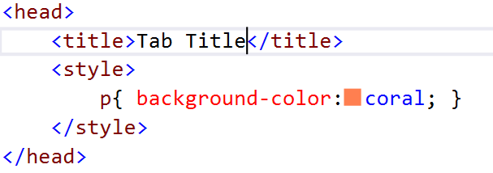
Applying Styles
Directly in the html tag (Inline Styles)
To the whole html page (Internal Styles)

Slide 5
External Styles (css)
Notes:
Best practice is to ensure that an HTML page contains no style information at all. If it does it can not be changed easily by making a change in a single place in a style sheet, and seeing that change ripple through hundreds of web pages instantly. The only exception would be applying bold (as <strong>) and italics as <em> to specific pieces of text.

Slide 6
CSS Selectors
HTML Tags
Class Names
ID Names
Selector
Rules
body
{
background-color: #EEFFD1;
font-family: Times, “Times New Roman”, Serif;
font-size: 1.0em;
}
Notes:
Using HTML tags to define new css rules is the most important as they affect all pages in the web site. Only apply styling to an HTML tag that is likely to apply to most of the pages in the site. For example most pages should have the same outer background colour and the same font and font size for the most of the paragraph text.
In this case a style has been applied to the body of the page, as the body contains everything on the page, then this style applies to all the page

Slide 7
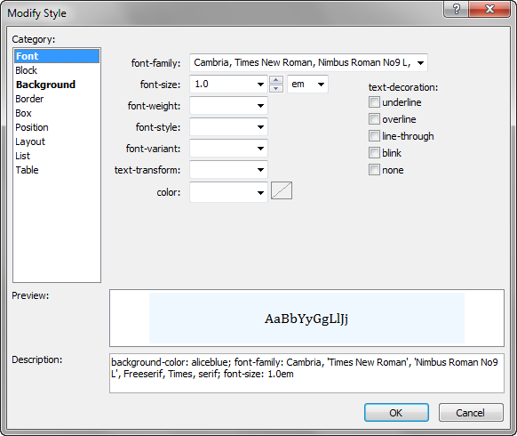
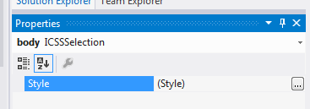
Design View Editing CSS Rules

Slide 8
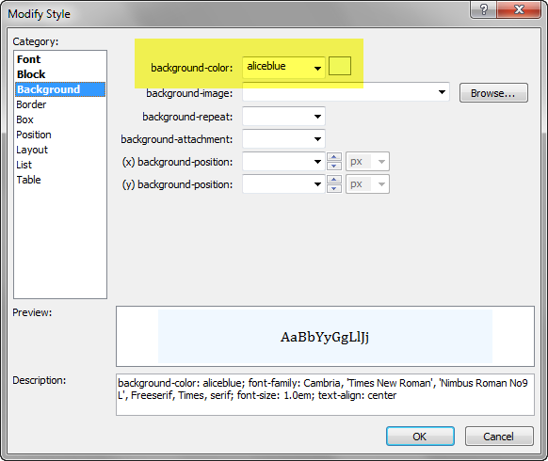
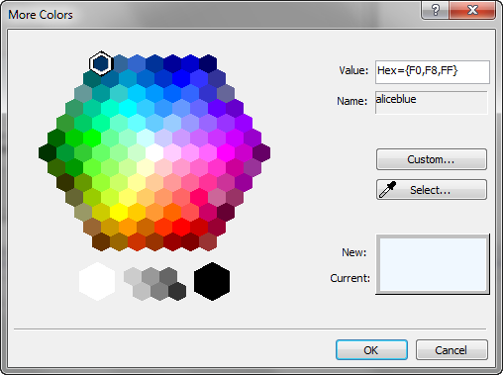
Background Styles
Notes:
Backgrounds can either be solid colour or can be an image which is displayed whole or repeated to form a pattern. Whenever an image is used it is better to have a background colour as well in case the image fails to load.

Slide 9
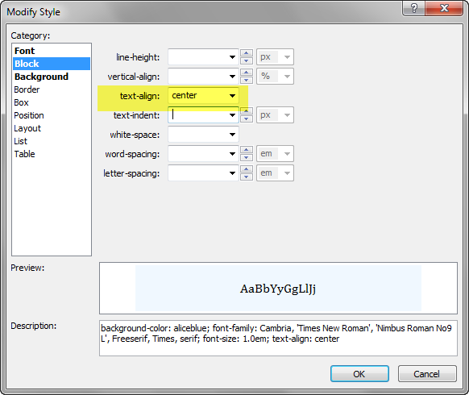
Block
Notes:
Block styles are most often used to align text, or to change the display mode from block to inline

Slide 10
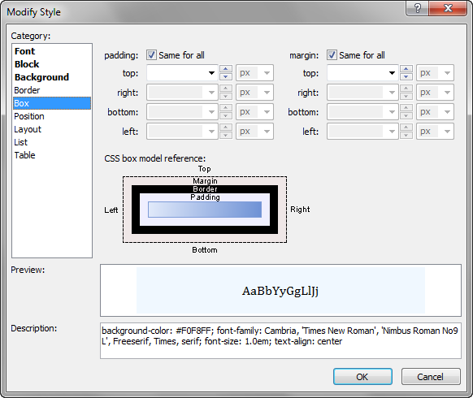
Box
Notes:
Box is one of the most widely used categories as it is used to add padding inside a box element such as section, as well as adding margin outside the element. Padding and margin can be individually set for top, left, right and bottom by un-ticking same for all. The size of the box and whether the element floats or not can also be set here.

Slide 11
Using a Class Selector
Classes can be applied to any HTML tag.
The same class can be used many times in one page.
.container
{
width:960px;
margin: auto auto;
background-color: #EEFFD1;
}
Notes:
The container has been set to be 960px wide, with a set background colour and margins which are automatically calculated. The end result is that the container will be cantered in whatever element it is inside of (usually the body)
The dot before the selector name indicates that this selector is a class selector and not an HTML tag selector. However this is not a good example of defining a class. Why??

Slide 12
Using a Class in HTML
<!DOCTYPE HTML>
<html>
<head>
<meta charset="utf-8">
<title>Page Title</title>
</head>
<body>
<div class=“container”>
</div>
</body>
</html>
Notes:
The class can be used on any HTML tag, in this case the <div> tag.
As there is usually only the one container for a page, container would be better defined as an id based selector (see next page). Note the class name in HTML has no dot preceding the name

Slide 13
Defining an ID Selector
#container
{
width:960px;
margin: auto auto;
background-color: #EEFFD1;
}
Notes:
ID selectors are unique names and the are identified in CSS by starting with a # symbol. An HTML page can only have one instance of that id.

Slide 14
Using an ID Selector
<!DOCTYPE HTML>
<html>
<head>
<meta charset="utf-8">
<title>Page Title</title>
</head>
<body>
<div id=“container”>
</div>
</body>
</html>
Notes:
ID selectors are used in an HTML page by giving the tag an id attribute as shown above. Only one can be used per html page. Again the # symbol preceding the name is only used in css not html

Slide 15
Linking External Style Sheets
<!DOCTYPE HTML>
<html>
<head>
<meta charset="utf-8">
<title>Page Title</title>
<link rel="stylesheet" type="text/css" href="css/myStyles.css">
</head>
<body>
<div id=“container”>
</div>
</body>
</html>
Notes:
The best practice is to store all the css rules in an external css file, and then attach that style sheet to whichever pages need it. This can be done from the CSS Styles panel on the right hand side of Dreamweaver, or in code view by dragging the file from the files panel into the code at the correct place. The correct place is in the <head> of the html page.

Slide 16
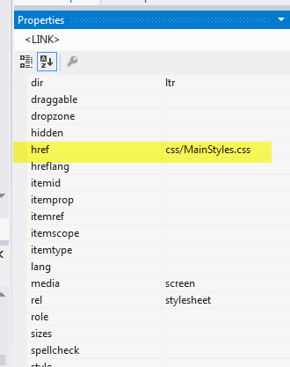
Linking Style Sheets
Code View: Drag the file into the <head>
Design View Edit: Properties->href..
Notes:
The easiest way to attach or link a style sheet is to click on the Attach Style Sheet icon in the CSS Styles panel. The style sheet can then be found using browse. The style sheet should be in a separate folder called css, styles, or stylesheets inside the web site.

Slide 17
Grouping Styles
h1, h2, h3, h4, h5, h6
{
font-family: Verdana, Arial, Helvetica;
}
h1
{
font-size: 2em;
}
h2
{
font-size: 1.6em;
}
Notes:
Styles can be defined for multiple selectors. So for example defining a font that will be used for all the headings is shown above, that is then followed by specific sizes for each heading alone.

Slide 18
Styling Links: Pseudo Classes
a { padding: 5px; }
a:link { color: blue; }
a:visited { color: purple; }
a:hover {background-color: grey; }
Notes:
In some cases such as the <a> hyperlink tag, the tag name can be followed by a pseudo class name such as hover, to indicate the style to be applied when the mouse is hovering over the element.

Slide 19
Defining Style Context
Style all the paragraphs
p { color: blue; }
Style all the paragraphs in a section
section p { color:red;}
Style all the paragraphs in an article
article p { color: green;}
Style all the links in ordered lists items
ol li a {…}
Notes:
Paragraphs for example can have different styles when they are inside sections, or articles. The order the rules are applied is important. The last applied has priority
What colour will paragraphs be inside and article inside a section??

Slide 20
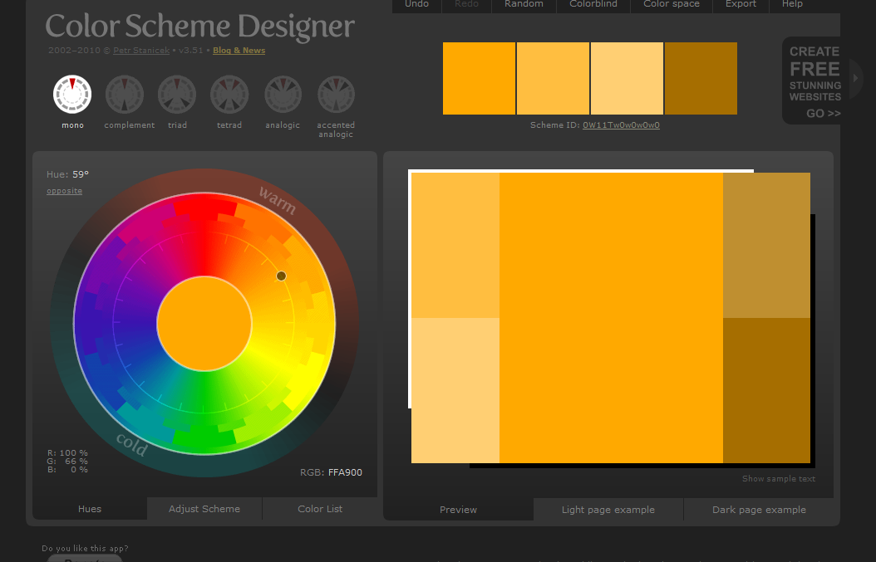
Colour Palettes
Export
Color Scheme Designer: 6 schemes with control on saturation and brightness
Color Combination: 7 schemes with control on saturation and brightness
Notes:
Selecting an appropriate set of colours for a web sight is quite difficult. The choice depends upon the intended mood. The web sites above offer a way of selecting a set of colours which complement each other based around a selected main colour. There is a choice of scheme type, depending on how many different colours you want to use in your site, and the overall effect.
The chosen scheme can be exported as an html + css page for future reference.

Slide 21
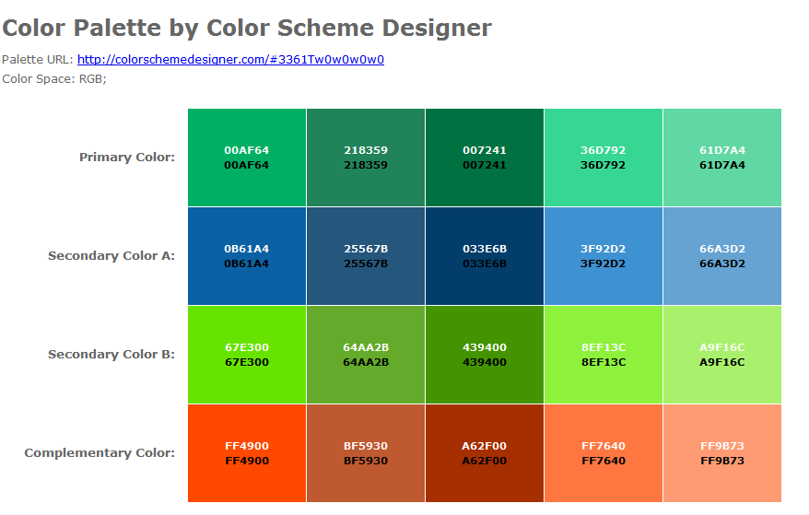
Exported Scheme

Slide 22
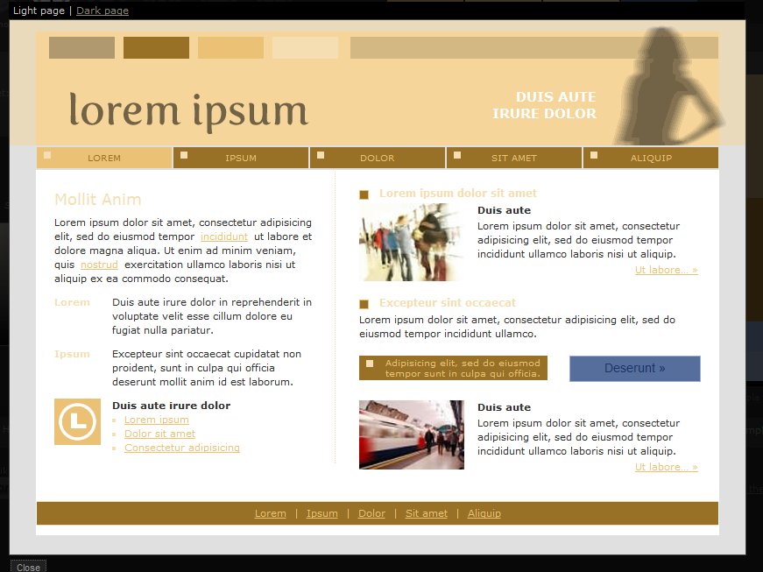
Light Page: Example
Notes:
To get some idea what the chosen scheme might look like there is a preview facility where a Light Page or a Dark Page can be viewed as shown above.

