Slide 1
Progressive Enhancement Using CSS 3
By Dr Derek Peacock

Slide 2
New Features
Borders – rounded corners
Backgrounds – multiple images
Colour – Opacity and gradients
Text – Shadows & Web Fonts
Box – Shadows
Transformations & Transitions
Media Queries – size and aspect ratios
Notes:
The above list are the main features that can be used to enhance the appearance of a web page, yet if the browser does not support the feature it will still display a usable web page. The enhancements just make the page appear more 3 dimensional. Transformations and Transitions can be used to provide simple animations with the minimal of code. This greatly reduces the need to add flash effects. Media Queries goes hand in hand with responsive desing to provide web pages that make the best use of mobile phone, tablet and desktop screens.

Slide 3
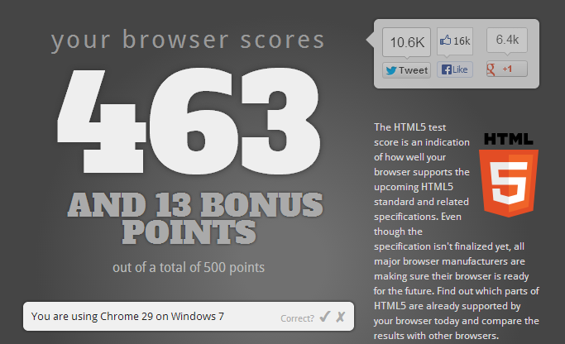
HTML5 Browser Compatibility
http://html5test.com/
Notes:
Not all browsers provide full support for HTML5 and CC3, Chrome scores highest. Html5Test.com can check how compatible a browser is.

Slide 4
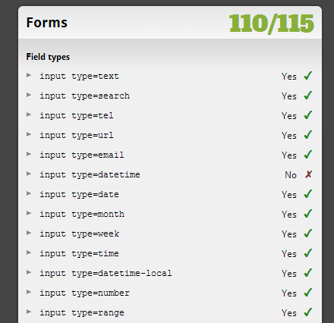
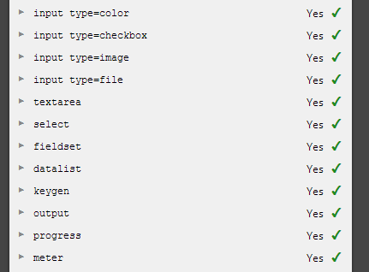
HTML5 Forms Support
Notes:
This page also lists the features that are supported in detail. These are just some of them.

Slide 5
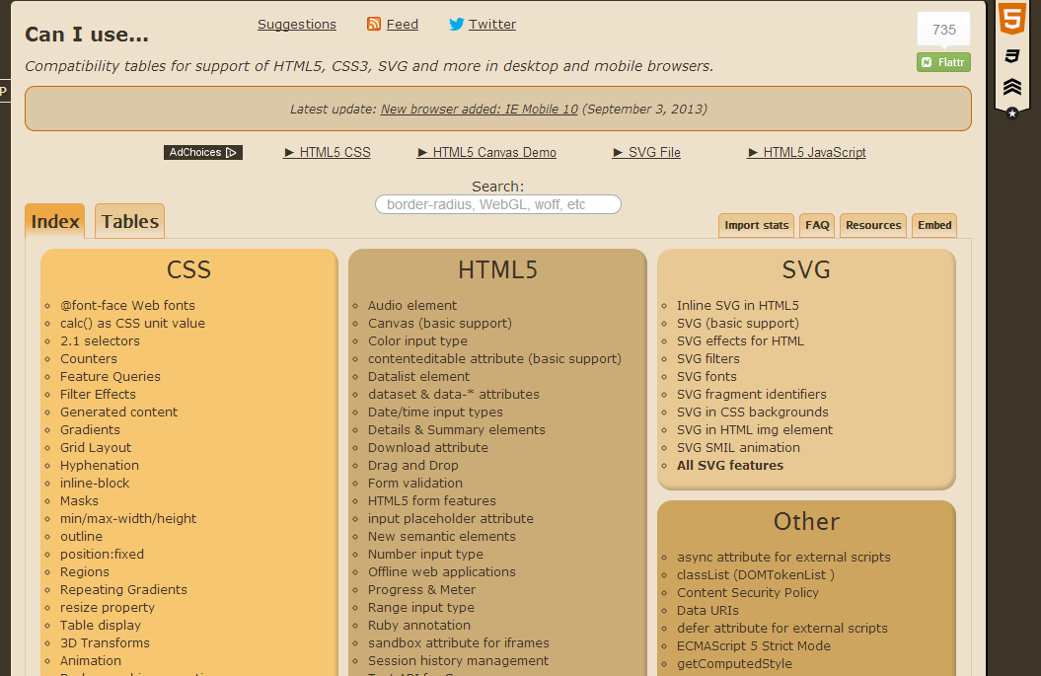
CSS3 Browser Compatibility
http://caniuse.com/
Notes:
To check for CSS3 support canIuse.com lists all the browser features supported by your chosen browser.

Slide 6
CSS3 Feature Support
border-radius
Notes:
If one feature is selected then the web site lists all the browsers that support it.

Slide 7
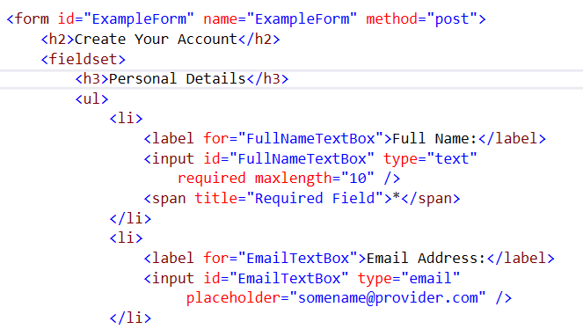
Forms Example 2
Notes:
This is another example of a way of structuring a form using in this case an un-ordered list to separate the fields in a fieldset. This however causes a validation breach as there is no legend. All fieldsets should have a legend. In this case a heading has been used instead.

Slide 8
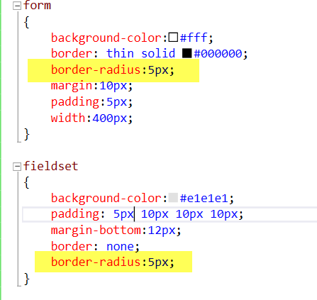
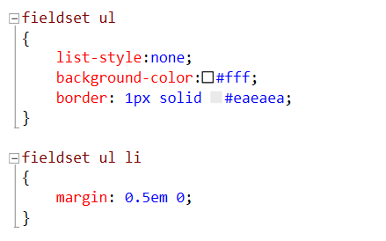
Forms Styling 2
Notes:
The difference in styling is the styling fieldset ul, and fieldset ul li. And the introduction of border radius which needs setting in the form and the fieldset as they define overlapping areas.

Slide 9
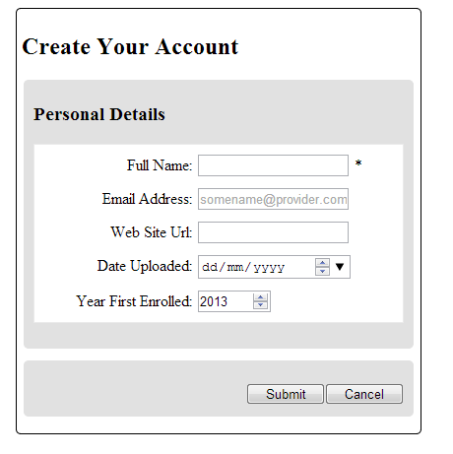
Rounded Corners
border-radius: 0px 0px 20px 20px;
border-radius: 20px;
Notes:
At the moment the effect is subtle, but will be enhanced later by adding box shadow.

Slide 10
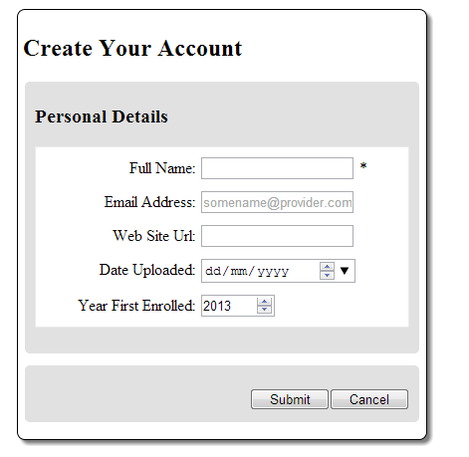
Box Shadow
Notes:
Visual Studio validates CCS3 and HTML5 and will prompt you if vendor specific styles need adding for browser compatibility. The resulting affect is to add a 3D appearance which will not be present if the browser does not support these CCS3 styles.

Slide 11
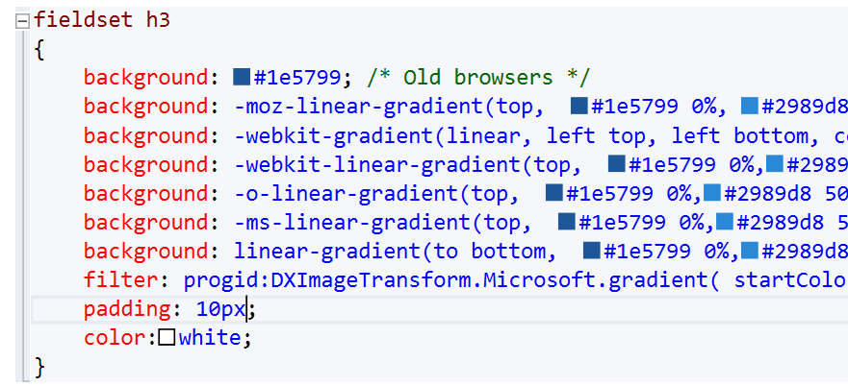
Gradient Fills

Slide 12
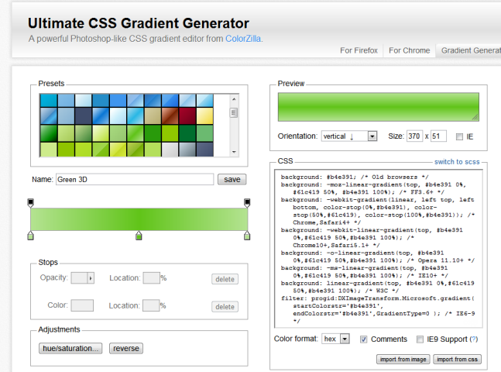
Gradient Generators
http://www.colorzilla.com/gradient-editor/

Slide 13
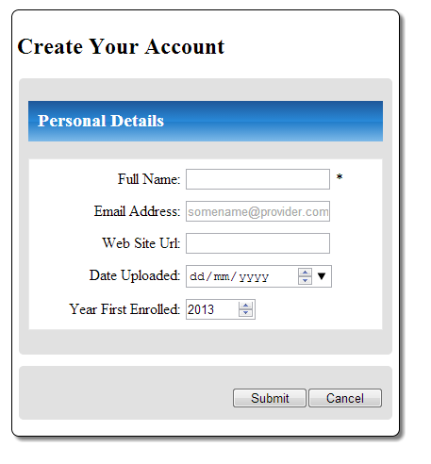
Using Gradient Fills

Slide 14
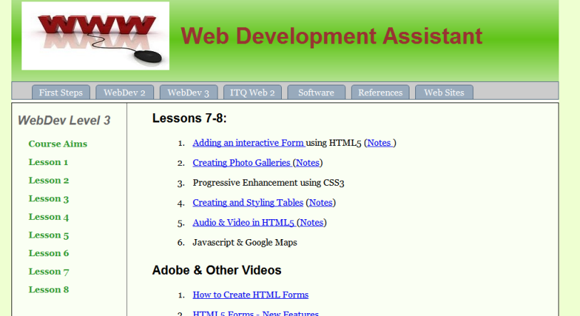
Gradient Fills – Another Example
Notes:
Gradient fills can typically be used in the header region, and rounded corners can be used to create menu entries that look like tabs.

Slide 15
Text Shadow
header h1
{
text-shadow: 2px 2px rgba(0, 0, 0, 0.5);
}
Notes:
Text Shadows can be used to give text a 3D like appearance, to make the shadow more subtle a transparent black is used so that background images or colours can show through.

Slide 16
Internet Explorer 8
Notes:
The same web site in IE8 looks very plain in comparison, but is still fully functional and can be used.

